Slide 1
Oil Industry Segment Update Lee K. Johnson Hess Corporation
Rail Energy Transportation Advisory Committee
Surface Transportation Board
April 17, 2024

Slide 2
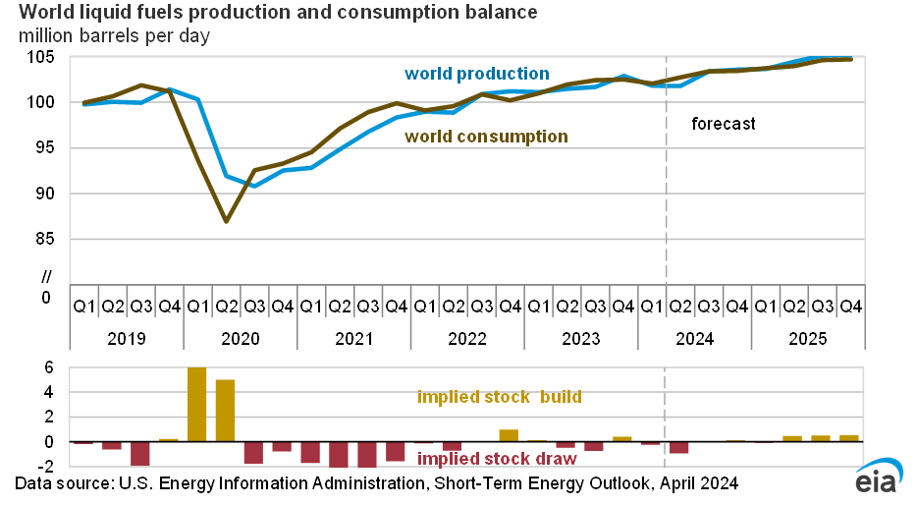
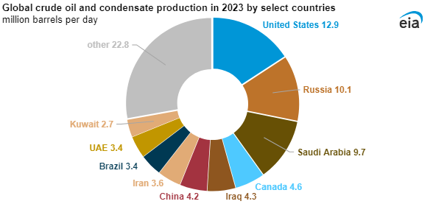
Global Production and Consumption Major Producing Countries
Source: EIA

Slide 3
Total US Refinery Capacity, Input & Crude Oil Production MBPD
PADD – Petroleum Administration Defense Districts
PA WV ND OK TX NM & Fed-OS CO MT UT WY AK CA
Source: EIA
Major Producing States

Slide 4
North American Crude By Rail
Origins and Destinations 2023
Annual Barrels
US Class 1 Railroad Carloads 2019 - 2023
Total 97.3 million barrels
Intra-US 65.2 MM 66.9%
Canada to US 32.1MM 33.1%
Intra-US OD’s – 62.5MM
From PADD 2 48.4MM 74.3%
To PADD 1 - 6.7MM 13.9%
To PADD 5 – 41.7MM 86.1%
From PADD 4 – 16.7MM 25.7%
To PADD 2 – 0.6MM 3.8%
To PADD 3 – 16.1MM 96.2%
Canada to US – 32.1MM
To PADD 1 – 2.4MM 7.4%
To PADD 2 – 0.6MM 2.1%
To PADD 3 - 24.3MM 75.5%
To PADD 5 – 4.8MM 15.0%
Source: Association of American Railroads
Source: EIA

Slide 5
ND Production & Modal Share MBPD
Source: North Dakota Pipeline Authority

Slide 6
Products of Petroleum Refining Class 1 Railroad Carloads 2019 - 2023
Source: Association of American Railroads

Slide 7
Suggested Take Aways
Global crude oil production and consumption continues to grow – EIA
US remains the #1 global crude oil producer – EIA
US refinery capacity has declined 600 KBPD from 2019 level – EIA
PADD 3 contributed 72.9% of US crude oil production in 2023 - EIA
US domestic and Canada to US CBR grew modestly in 2023 - EIA
PADD 2 contributed 74.3% of US CBR in 2023 – EIA
Rail shipment of refined product grew 6.3% 2022 to 2023 – AAR
Refined product carloads average of nearly 500K annually. - AAR
Refined product rail returned to pre-pandemic levels in 2023 - AAR

