Slide 1
Oil Industry Segment Update Lee K. Johnson Hess Corporation
Rail Energy Transportation Advisory Committee
Surface Transportation Board
October 26, 2022

Slide 2
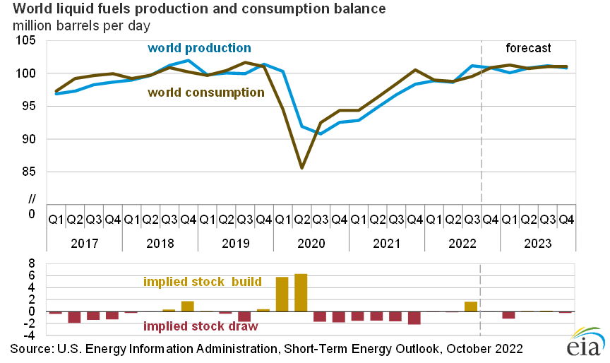
Global Production and Consumption Top Five Producers and WTI Pricing
WTI Prices
Monthly Averages
September 2019 $56.95
September 2020 $39.63
September 2021 $71.65
March 2022 $108.50
April 2022 $101.78
May 2022 $109.55
June 2022 $114.84
July 2022 $101.62
August 2022 $93.67
September 2022 $84.26
Source: EIA

Slide 3
Total US Refinery Input and Crude Oil Production MBPD
Source; EIA

Slide 4
US Crude Oil Imports and Exports MBPD
Source: EIA

Slide 5
Oil Land Rig Count
Source: Baker Hughes

Slide 6
ND Production & Modal Share MBPD
Source: North Dakota Pipeline Authority

Slide 7
US/Canada CBR MBPD
Source - EIA

Slide 8
Bakken CBR Destinations - % Bakken = approximately 90% of US Total
Source: EIA

Slide 9
Highlights
Global crude oil production exceeded consumption during 3Q 2022; inventory build - eia
US remains #1 crude oil producer; production is down 4.9% from pre-pandemic level - eia
Average monthly WTI down 26.6% from June high; up 47.9% from 2019 – eia
US refinery input has returned to equal pre-pandemic levels - eia
US production equals 74.1% of refinery input; Canada is largest import source – eia
Crude oil exports exceeding imports by 10.3% - eia
Land rig count has recovered to 4.5% above pre-pandemic levels – baker hughes
ND crude oil production is down 24.6% from pre-pandemic levels – eia
ND CBR rail market share down to 6%; approximately one train per day - ndpa
US and CAN CBR is down 63.8%, US down 66.7%, CAN to US down 60% from 2019 – eia
Bakken CBR represents 90% of US volume; there is some CBR growth in the Rockies – eia
The west coast receives 74.5% and the east coast 24.4% of Bakken CBR -eia

