Slide 1
RETAC – November 16, 2021
Mark Huston
Louis Dreyfus Company LLC

Slide 2
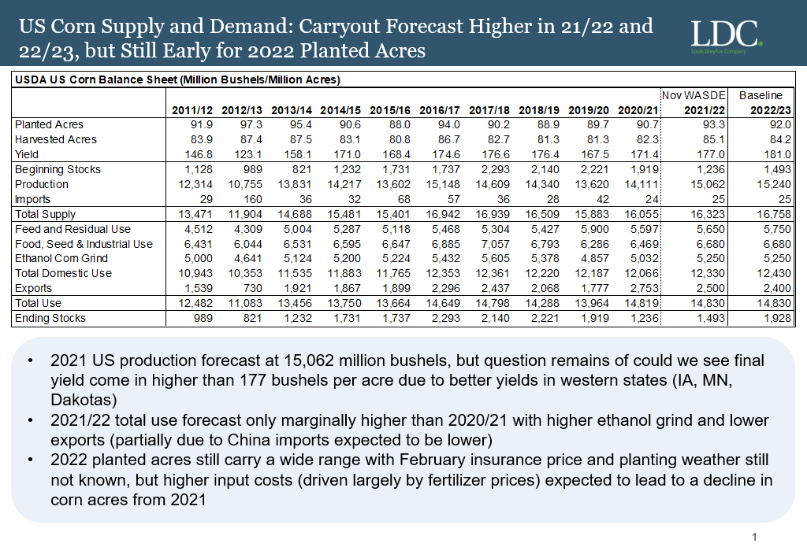

Slide 3
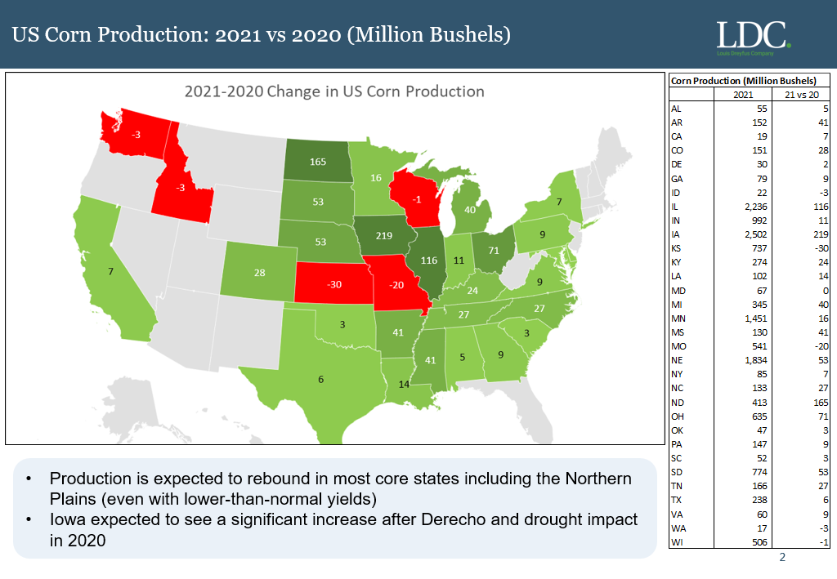

Slide 5
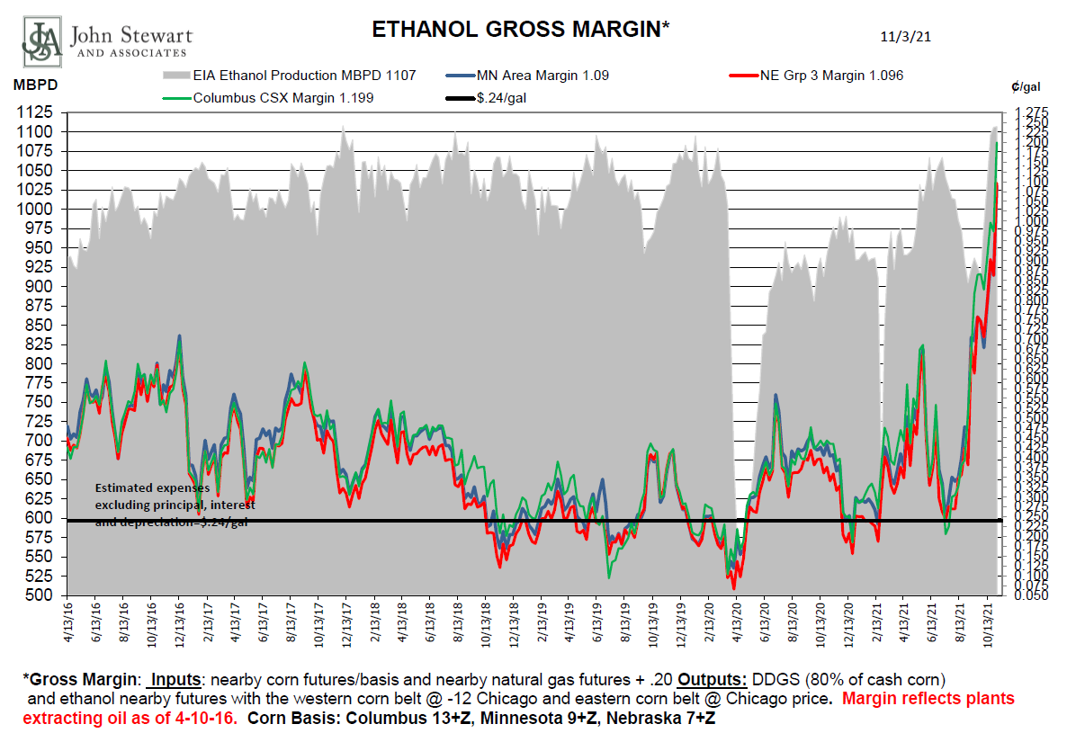
ETHANOL GROSS MARGIN

Slide 6
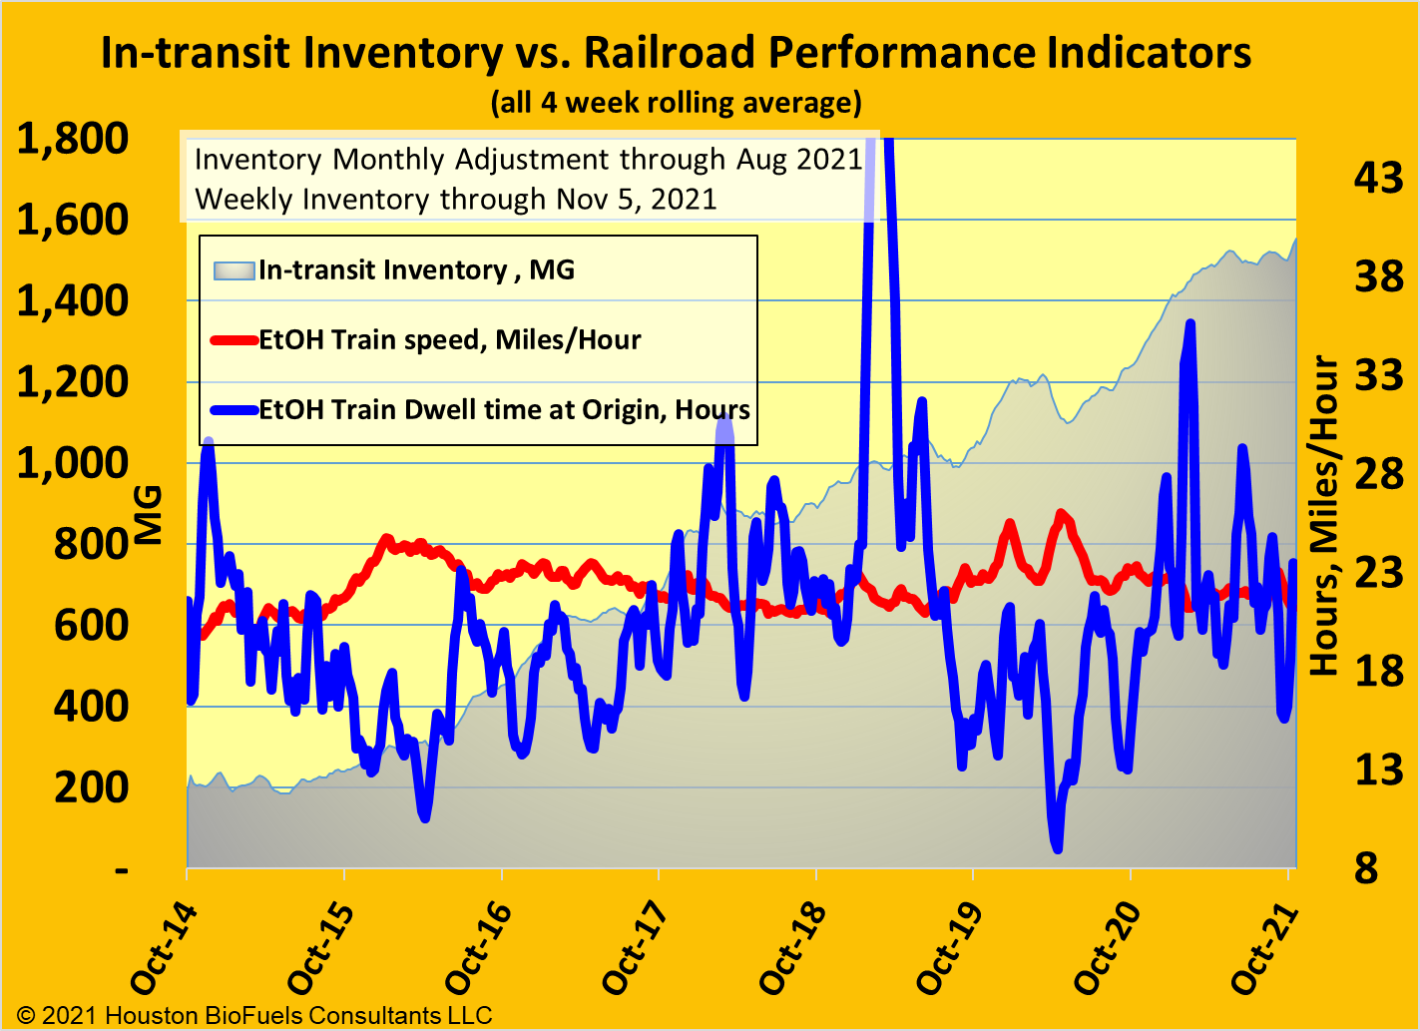
Intransit Inventory vs Railroad Performance Indicators

Slide 7
Ethanol Production vs Exports (kbd)

Slide 8
SUMMARY OF BIOFUELS
August Production was 225 MM Gallons combined Biodiesel and Renewable Diesel

Slide 9
SUMMARY OF BIOFUELS
Ethanol production increased to pre covid levels as has gas consumption
Ethanol exports thru July 870MGals, Strong exports projected now thru 1st quarter 2022 at a 1.5mm Gal pace/month
Margins in ethanol have significantly improved from negative levels during pandemic. Margins are all in the nearby curve, 30-45 day, with forward curve above breakeven levels but significantly less that nearby margins
Lease car supply very tight and getting very expensive. Federal mandate on DOT 111”s approaching in 2023.
Bio and Renewable Diesel margins- Given the rally in cash BO prices ( futures and refined) renewable margins have remained suppressed
Renewable Diesel will see an additional 1.0 bil gal of capacity come online (>100% increase) over the next couple years
Rail service is one of the biggest risks facing renewals today. PSR cost cutting has devasted crew base and other rail resources
Federal vaccine mandate looming over all companies, with 100 or more employees, could be catastrophic to all industries but especially so to rail carriers

