Slide 1
RETAC
Jeff Eliason
April 22, 2021

Slide 2
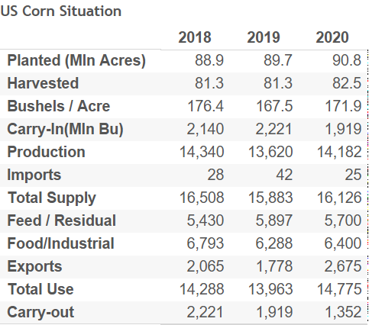
US CORN SUPPLY & DEMAND
Notes:
Exports are projected to be highest on record

Slide 3
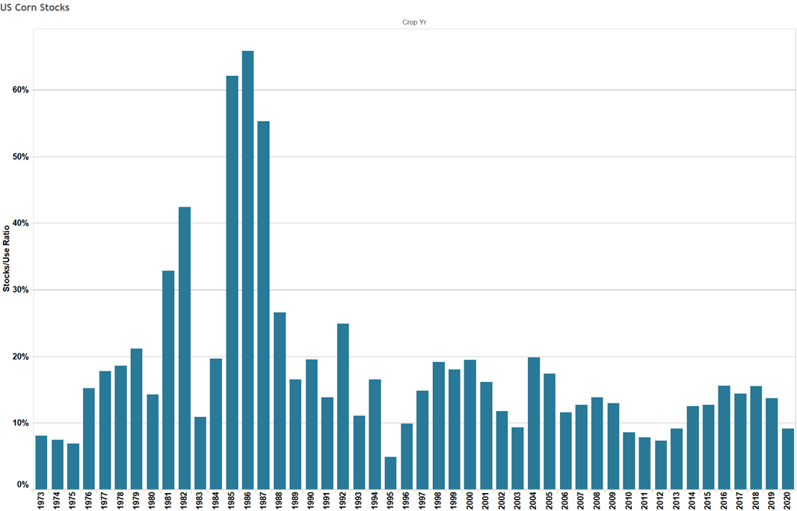
US CORN STOCKS TO USE
Notes:
Ending Stocks lowest since 2012

Slide 4
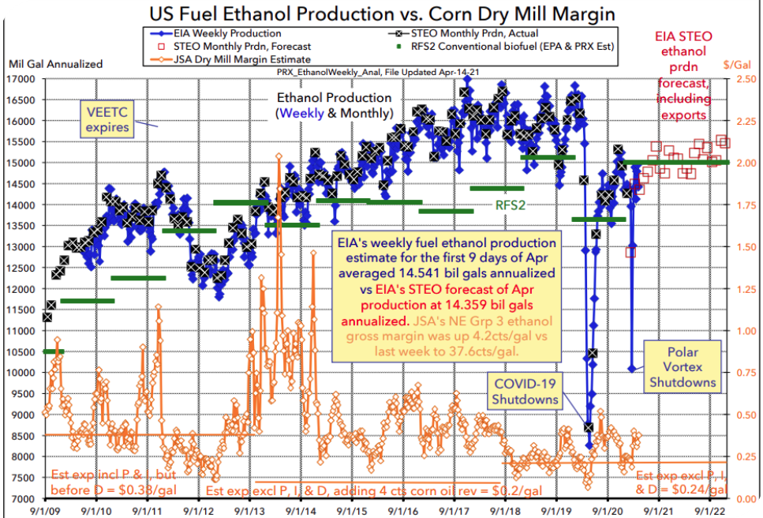
Source: PRX

Slide 5
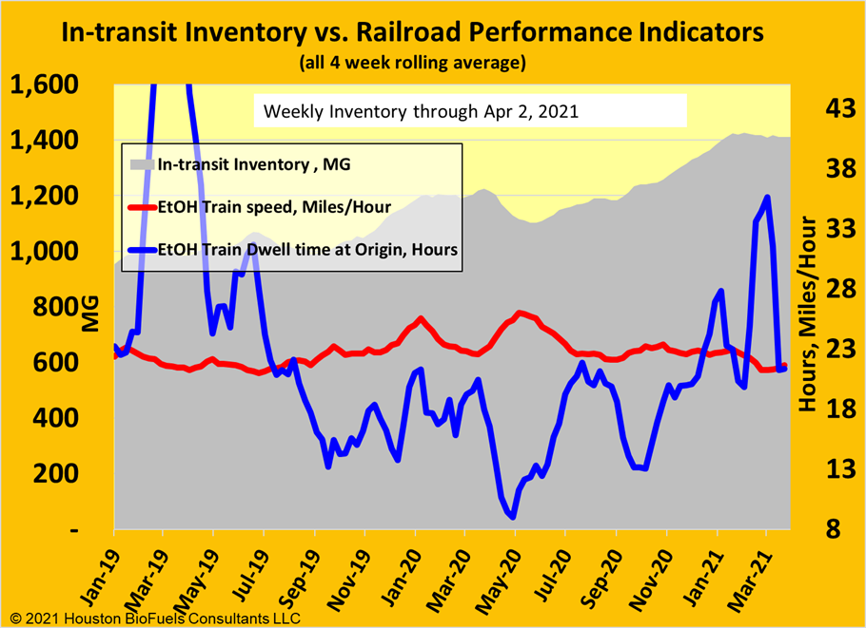

Slide 6
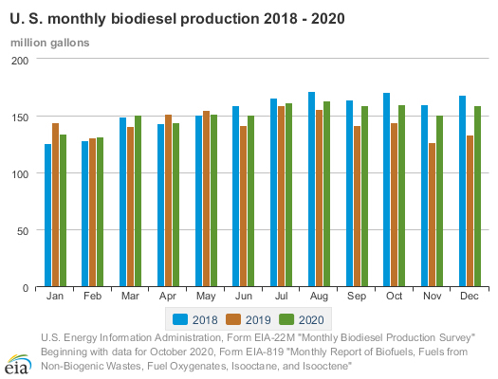
Notes:
Biodiesel still below pre-Covid levels

Slide 7
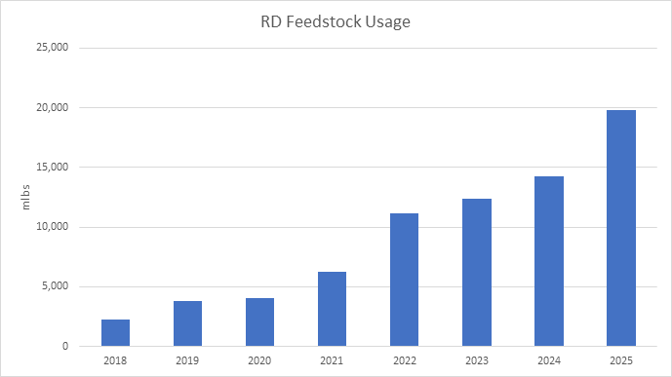
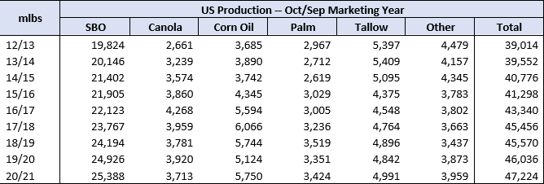
RENEWABLE DIESEL

Slide 8
SUMMARY OF BIOFUELS
Ethanol production still below pre pandemic levels by about 10%
For calendar 2020, exports totaled 1,438 MG, 6.4% less than 2019. In 2019, exports totaled 1,536 MG, 11% less than in 2018
Ethanol Margins – rising corn prices overshadowing increase in ethanol sales price
Bio and Renewable Diesel margins – As RD increases in production Non Integrated Bio Diesel plants will have difficulty staying afloat
Rail lease fleets- increasing steel prices impacting leases, about 1/3 of fleet still needs to be changed out, the preferential treatment of DOT 117J cars is slowing down the change over
Rail service experiencing challenges on both power and crew availability – would like to see staffing continue to increase as we continue to utilize rail for distribution

