Slide 1
RETAC
Paducah, KY November 14, 2019

Slide 2
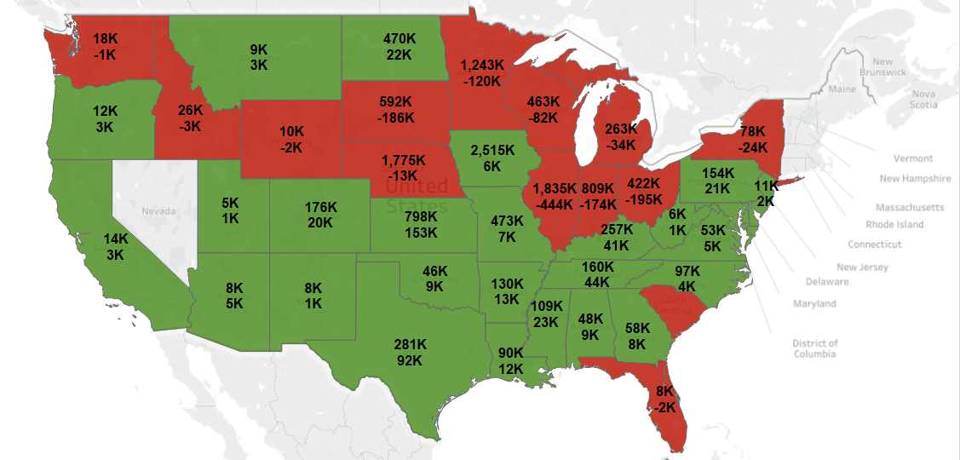
US Corn Production 2019 vs 2018

Slide 3
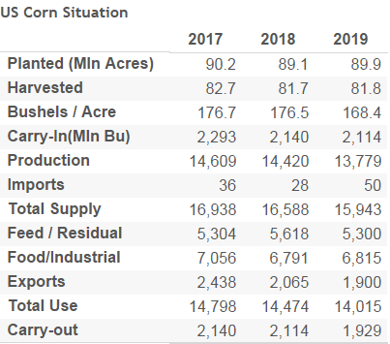
US Corn Supply & Demand

Slide 4
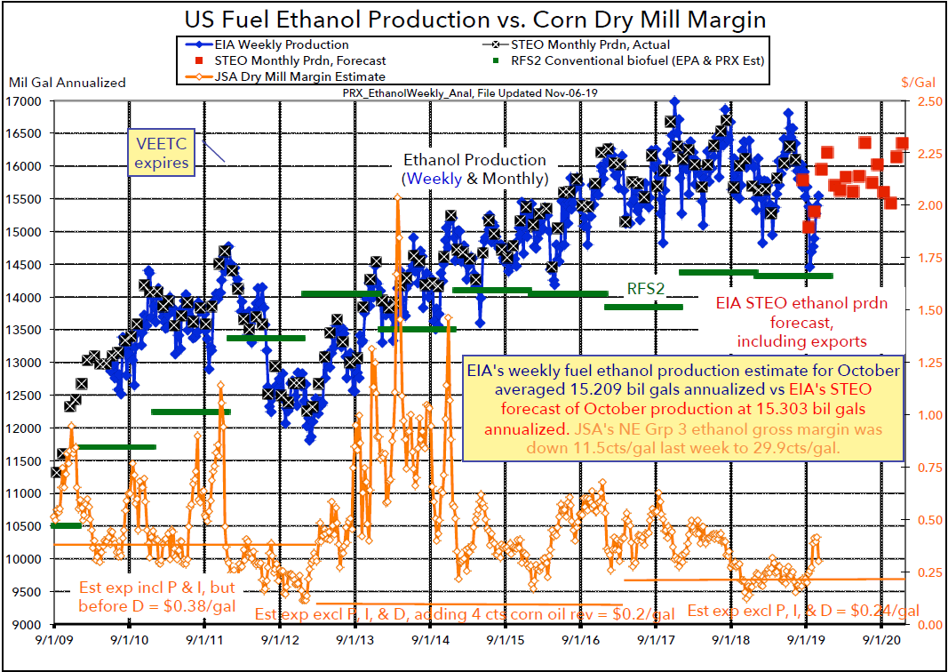
US Ethanol Production vs Milling Margin
Source: PRX

Slide 5
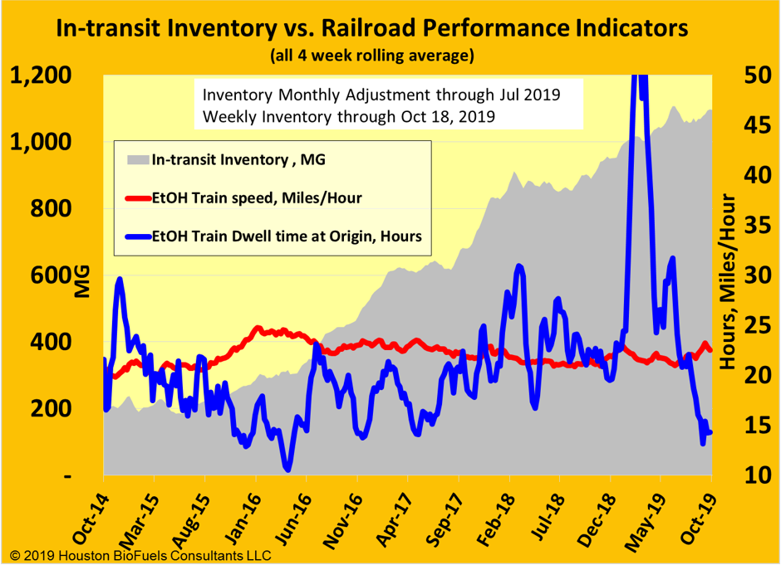
In-transit Inventory vs. Rail Performance

Slide 6
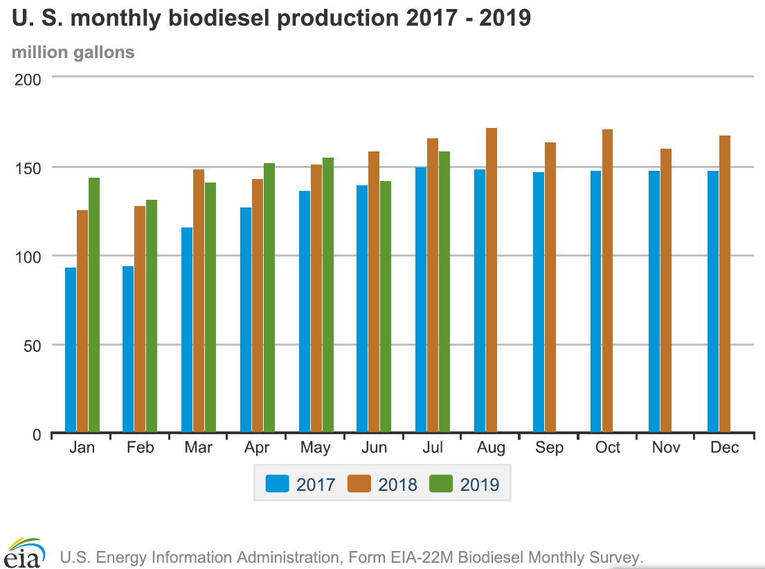
Monthly Biodiesel Production

Slide 7
Summary of Bio-Fuels
Ethanol production is still greater than domestic demand + exports
Tariffs are still in place for Brazil and China
E-15 has been approved for year round usage – expect slow adoption
Margins in both ethanol and bio-diesel are under pressure
Some plants are slowing down production or have been closed
No issues with rail service today

