Slide 1
RETAC – October 7, 2020
Mark Huston
Louis Dreyfus Company LLC

Slide 2
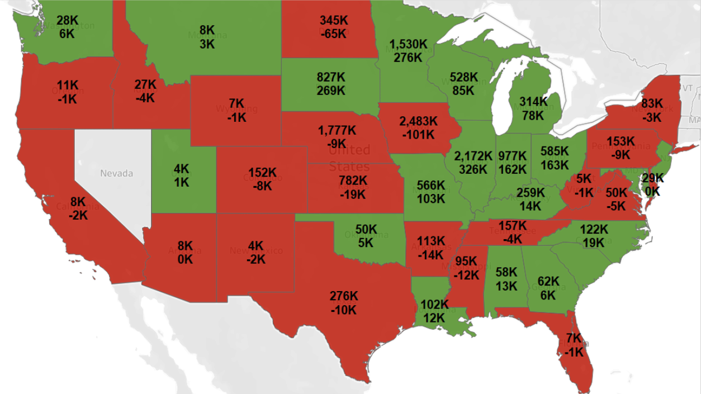
US CORN PRODUCTION 2020 vs 2019

Slide 3
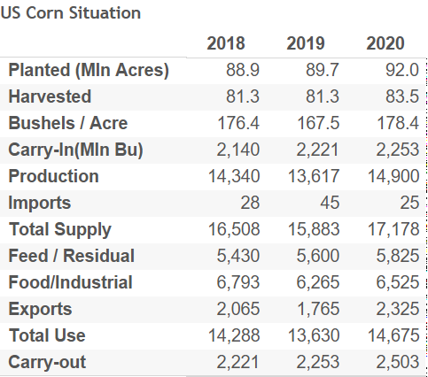
US CORN SUPPLY & DEMAND

Slide 4
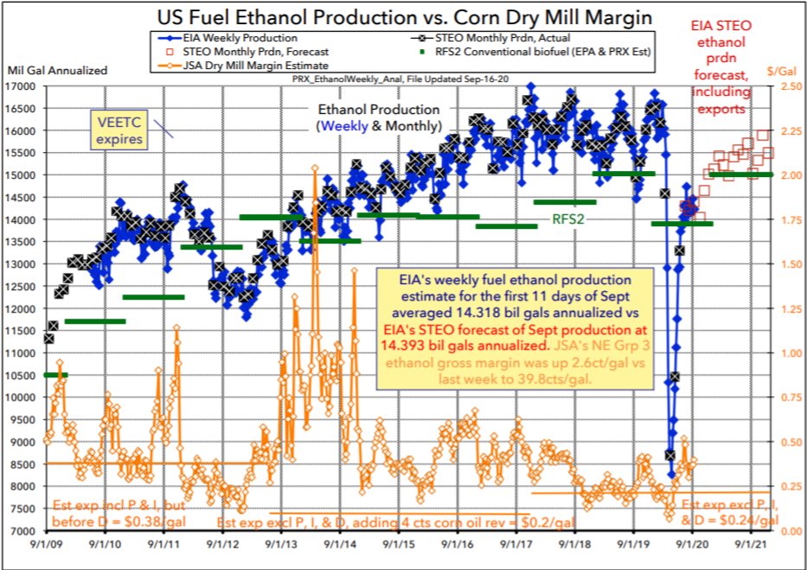
US ETHANOL PRODUCTION VS MILLING MARGIN

Slide 5
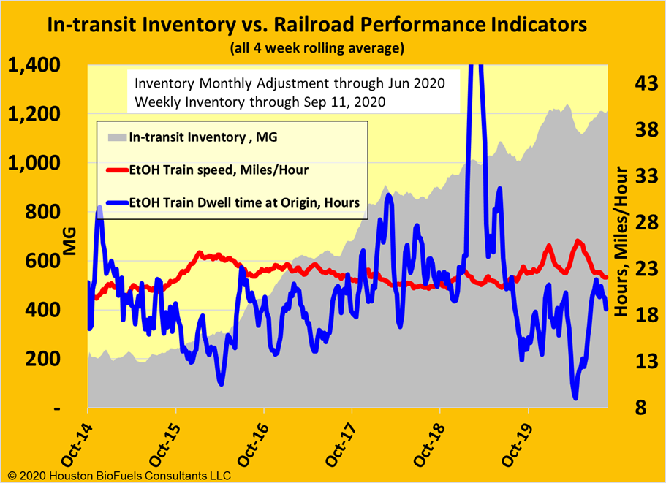
IN-TRANSIT INVENTORY VS RAIL PERFORMANCE

Slide 6
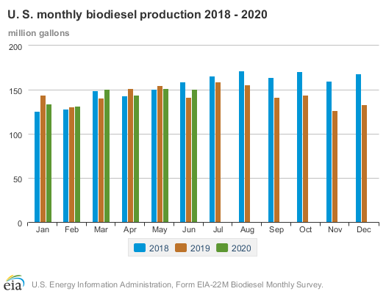
MONTHLY BIODIESEL PRODUCTION

Slide 7
SUMMARY OF BIOFUELS
Ethanol production drop by close to 50% during pandemic as did gas consumption
Ethanol exports thru July 860MGals, Est total for 2020 1.25 BGals
China is still on sidelines on ethanol purchases as part of Phase 1
EPA has rejected 54 of 68 refinery exemptions. Remaining 14 under review
Margins in ethanol have improved from negative levels during pandemic
Margins in bio diesel have been suppressed due to feed stock pricing
No major issues with rail service today
Lease cars are available, and pricing is somewhat soft

