Slide 1
Oil Industry Segment Update Lee K. Johnson Hess Corporation
Rail Energy Transportation Advisory Committee
Surface Transportation Board
April 22, 2021

Slide 2
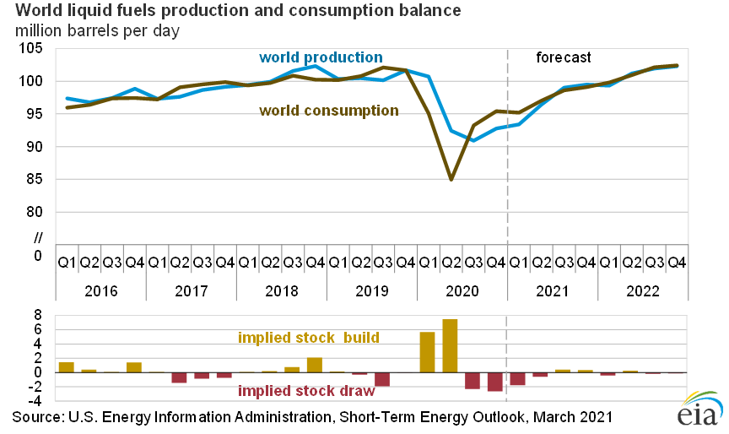
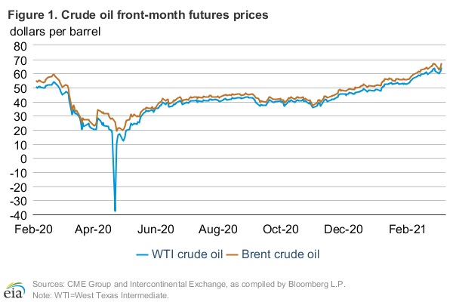
Global Production and Consumption WTI and Brent Price Reaction

Slide 3
US Crude Oil Production MBPD
Source: EIA

Slide 4
US Land Rig Count
Source: Baker Hughes

Slide 5
Texas, New Mexico and Oklahoma Production MBPD
Sources: TRRC and EIA

Slide 6
CBR Within PADD 3 and to West Coast 1,000’s BPD
Source; EIA

Slide 7
Williston Basin Crude Oil Production and Modal Share MBPD
Sources: ND Pipeline Authority and EIA

Slide 8
Total US and Canada CBR KBPD
Source: EIA

Slide 9
Canada CBR to Destinations in US KBPD
Source: EIA

Slide 10
Summary
Global crude oil consumption exceeding production with equilibrium 3Q 2021
WTI and Brent pricing have recovered and exceed pre-pandemic levels
US production is down 15.3% and rig count is down 46% both YOY
US Southwestern production has recovered and exceeds pre-pandemic volumes
Southwest CBR is down 77% from already small pre-pandemic levels
Bakken production is down 26.3%, pipe down 15.5%, and rail down 40% all YOY
CBR US to Canada disappeared; Canada to US down 38%; to gulf down 61%
DAPL’s future uncertain with litigation ongoing; status conference held April 10th
COE did not exercise its right to shut-down DAPL over the vacated easement; for now
COE reported it plans to complete a new EIS by March 2022; court and plaintiffs frustrated
DOJ advised Court that the Administration will not shut down DAPL while EIS is conducted
Court date scheduled for April 19th has been continued 10 days; results are unpredictable
DAPL expected to pursue all available legal options

