Slide 1
Oil Industry Segment Update Kent Avery PBF Energy
Rail Energy Transportation Advisory Committee
Surface Transportation Board
November 14, 2019

Slide 2
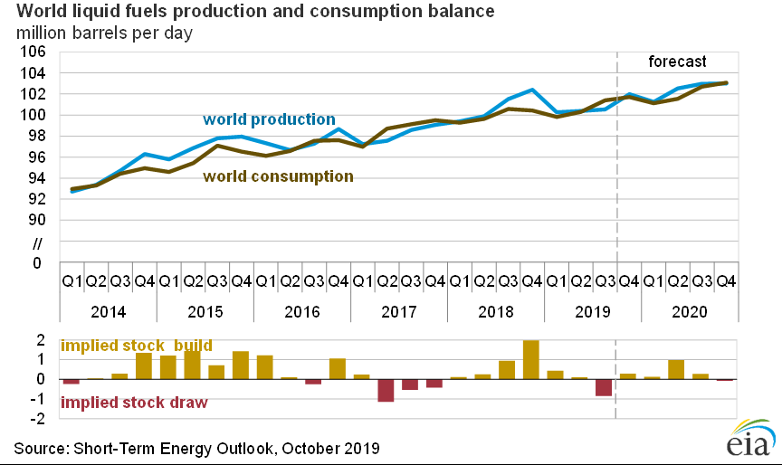
Oil Industry Segment Market Environment
Global production/consumption in balance
Production Consumption
3Q 2016 97.28 MBPD 97.54 MBPD
3Q 2017 98.59 MBPD 99.13 MBPD
3Q 2018 101.52 MBPD 100.57 MBPD
3Q 2019 100.55 MBPD 101.40 MBPD
US Crude Oil Production / Exports / Refinery Capacity / Share
Production Exports Refinery Input Domestic Share
3Q 2016 8.62 MBPD 0.17 MBPD 18.3 MBPD 46.2%
3Q 2017 9.33 MBPD 0.20 MBPD 18.6 MBPD 49.1%
3Q 2018 11.25 MBPD 0.25 MBPD 18.6 MBPD 59.1%
3Q 2019 12.24 MBPD 0.28 MBPD 18.8 MBPD 63.6%
WTI price in 2019 remains variable in a fairly narrow range [Source: EIA]
May $60.83 Jun $54.66 Jul $57.35 Aug $54.81 Sep $56.95
US land rig count down 22.8% from 1,046 in 2018 to 807 [Source: Baker Hughes]
10/25/2019 Texas 418 (51.8%) New Mexico 110 (13.6%) North Dakota 53 (6.6%)
Domestic CBR volumes flat; growth is imported Canadian crude oil

Slide 3
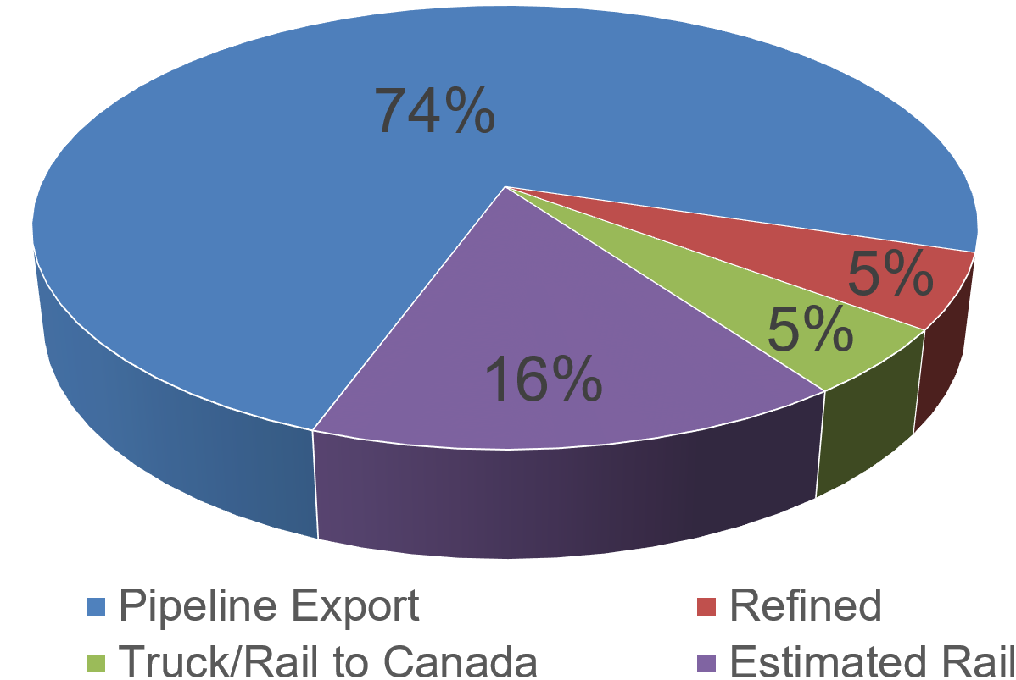
Williston Basin Crude Oil Modal Share
August, 2019
 | Average Production/BOPD | Rail/BOPD est.
6/2014 | 1,092,519 | 644,586
6/2015 | 1,211,328 | 569,324
6/2016 | 1,027,131 | 297,868
6/2017 | 1,032,873 | 72,301
6/2018 2/2019 | 1,225,510 1,335,064 | 232,847 226,961
8/2019 | 1,477,394 | 236,383
PADD 2 Destinations August, 2019
West Coast 67.0%
East Coast 28.3%
Gulf Coast 4.6%
[Source: EIA]
Source: ND Pipeline Authority

Slide 4
Permian Oil Production
Frac sand remains in surplus [Source: WSJ]
Crude oil production volumes continue to grow [Source: EIA]
August production 4.4 MBPD [Source: EIA]
Estimated pipeline capacity 3.9 MBPD [Source: Tudor, Pickering, Holt & Co.]
Pipeline capacity being increased to meet demand [Source: EnSys]
CBR volume within and from PADD 3 declined 18.6% since February
July, 2019 1.4 MB moved within PADD 3 (approximately 2.1K C/L’s) [Source: EIA]
July, 2019 0.39 MB moved PADD 3 to 5 (approximately 565 C/L’s) [Source: EIA]
Potential barriers to long term CBR
Cost differential
Increasing pipeline capacity
Limited rail loading terminal capacity
Availability of rail unloading capacity depends on market

Slide 5
Changing CBR Patterns – July, 2019 Snapshot
CBR shipments from Canada to the US have doubled since January
EIA reports 24.31 MB moved by rail within US and from Canada
12.95 MB were Intra - U.S. movements (53.3%) approximately 18,500 carloads
11.36 MB were U.S. Imports from Canada (46.7%) approximately 17,500 carloads
The 11.36 MB imported from Canada were shipped to:
1.10 MB to PADD 1 – East Coast (9.7%)
2.43 MB to PADD 2 – Midwest (21.4%)
6.26 MB to PADD 3 – Gulf Coast (55.1%)
0.00 MB to PADD 4 – Rocky Mountain (0.00%)
1.57 MB to PADD 5 – West Coast (13.8%)

Slide 6
Washington State SB 5579
May 9, 2019 the governor of the State of Washington signed into law the Engrossed Substitute Senate Bill 5579, Crude Oil by Rail, Vapor Pressure effective July 28, 2019.
July 17, 2019 the Attorneys General of the states of North Dakota and Montana filed an Application for Preemption of the Washington law with PHMSA
July 24, 2019 a Public Notice and Invitation to Comment was published in the Federal Register
August 23, 2019 Sandia National Laboratory reported on an study funded by DOT, DOE and Transport Canada concluding that there was “insufficient evidence to show that light sweet crude oil from the Bakken region significantly increased the probability of fire and explosion in case of release.”
September 23, 2019 comments were received by PHMSA
October 23, 2019 rebuttal comments were received by PHMSA

Slide 7
Summary
Global crude oil production continues to meet slowly growing global demand
US crude oil production growth continues to surpass growth in exports; Canadian imports remain dominant
Market share for domestic crude oil has increased dramatically
Crude oil prices remain volatile but within a fairly narrow range
US land based rig count down 22.8% year-over-year; production up 8.8%
US onshore E&P growth remains in pipe centric production regions
Bakken production increased 20.6% year-over-year; CBR volume flat
Permian production now exceeding 4.4 MBPD; CBR volume declining
CBR volumes from Canada have doubled since January
Washington State’s SB 5579 “Crude Oil by Rail – Vapor Pressure” presents a threat to the uniform application of federal hazmat regulations

