Slide 1
Oil Industry Segment Update Lee K. Johnson Hess Corporation
Rail Energy Transportation Advisory Committee
Surface Transportation Board
October 7, 2020

Slide 2
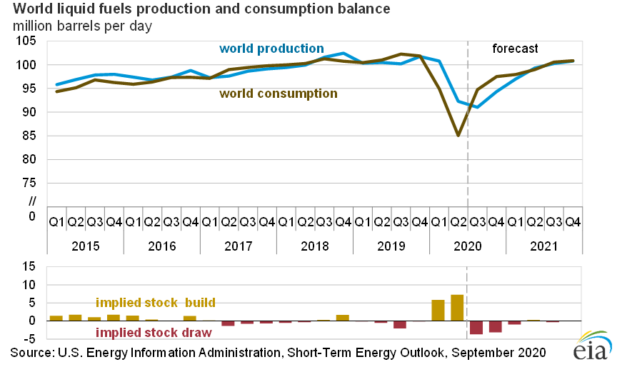
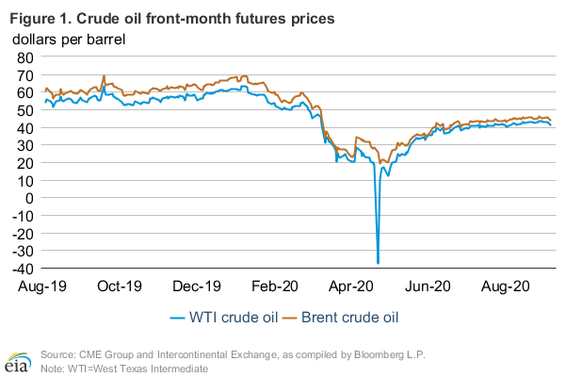
Global Production and Consumption WTI and Brent Price Reaction

Slide 3
US Crude Oil Production MBPD
Source: EIA

Slide 4
US Land Rig Count
Source: Baker Hughes

Slide 5
Texas, New Mexico and Oklahoma Production MBPD
Sources: TRRC and EIA

Slide 6
CBR Within PADD 3 and to West Coast 1,000’s
Source; EIA

Slide 7
Williston Basin Crude Oil Production and Modal Share MBPD
Sources: ND Pipeline Authority and EIA

Slide 9
Total US and Canada CBR KBPD
Source: EIA

Slide 10
Canada CBR to Destinations in US KBPD
Source: EIA

Slide 11
Summary
Global crude oil consumption fell faster than production in Q1 and Q2 2020
WTI and Brent pricing fell as the inventory surplus grew; pricing still volatile
US production reduction was mostly land-based; rig count down dramatically
US Southwestern production fell; primarily in Texas; recovery started in June
Southwest CBR dropped dramatically and remains a minor export factor
Williston Basin production fell dramatically; pipeline largest export loser initially
ND shut-in well count situation improved in May and June
Total CBR in the US and Canada down 78% from January to June
CBR volumes from Canada to US are down 89%; biggest reduction to the Gulf
PHMSA ruled in May that federal law preempts Washington State’s SB 5579
DAPL’s future remains unresolved as the shutdown/empty court order has been stayed pending an additional environmental impact study

