Slide 1
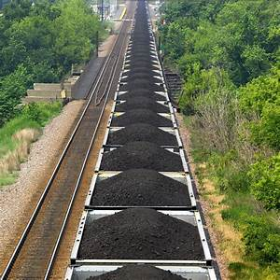
Utility Segment Update Surface Transportation Board RETAC meeting April 22, 2021
Presented by:
Bette Whalen / Fuel Specialist Principal
Lower Colorado River Authority

Slide 2
Effects of Covid on Utilities
Difficult to parse out effects that could be solely attributed to Covid pandemic
Possible that some effects could be a combination of PSR decisions and operating practices that have been implemented which may have been amplified when the pandemic occurred
For utilities, there was a shift from commercial/office load to residential load causing utilities to analyze the change in electricity demand

Slide 3
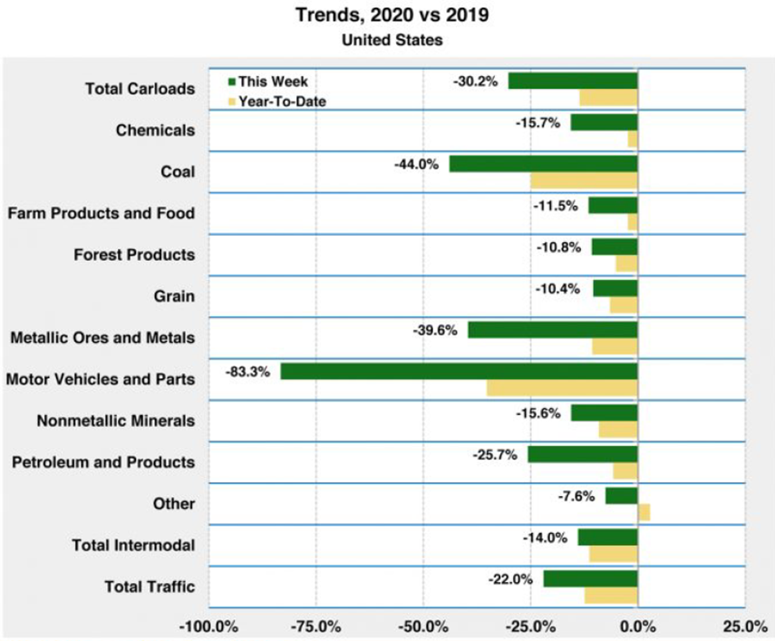
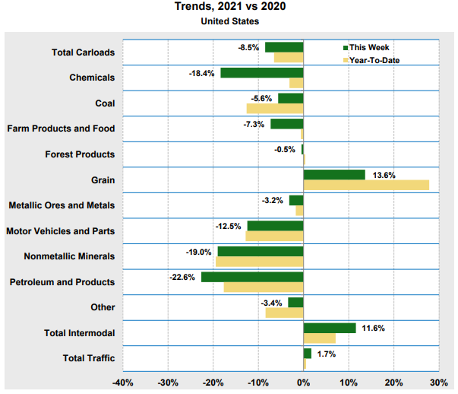
Effects of Covid on Utilities
May 2019/2020 vs Feb 2020/2021 trends in US Rail Traffic

Slide 4
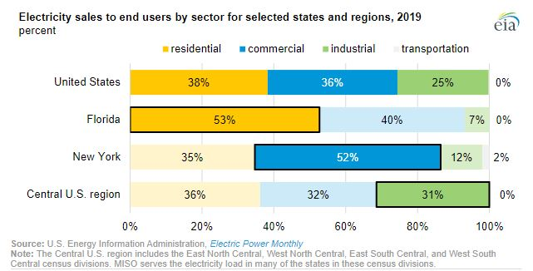
Effects of Covid on Utilities
EIA May 7, 2020
Daily electricity demand impacts from COVID-19 mitigation efforts differ by region
Shifts in demand for residential, commercial, industrial and transportation by region likely impacted shifts in rail transportation service by region

Slide 5
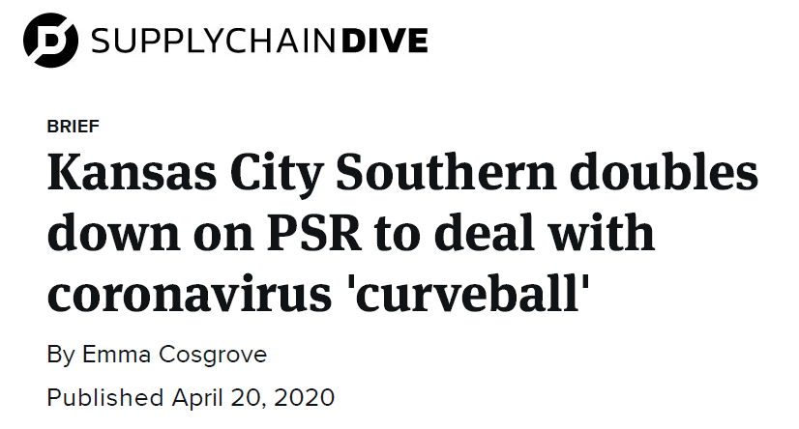
Effects of Covid on Utilities
Bullets shown below are quotes/excerpts from the article in SuppyChainDive
Retiring locomotives has been a key part of KCS and its peers’ transitions to PSR
The railroad has removed 20% of its fleet since adopting PSR in January 2019
The railroad removed an additional 50 locomotives in this fashion in reaction to the COVID-19 outbreak
The trick for KCS, and all Class I railroads, is the same challenge many global businesses are facing right now: How does a business cut costs to weather the short term without damaging its ability to respond quickly when demand returns?
Coordinating with customers is one way

Slide 6
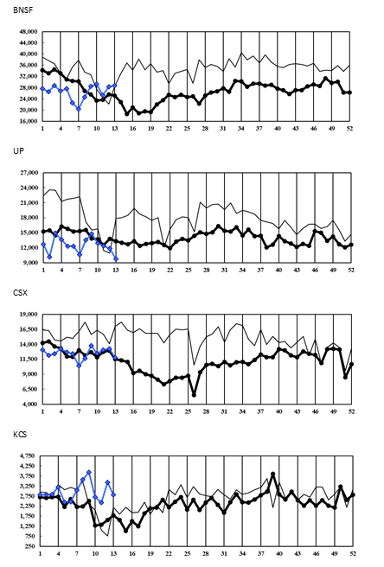
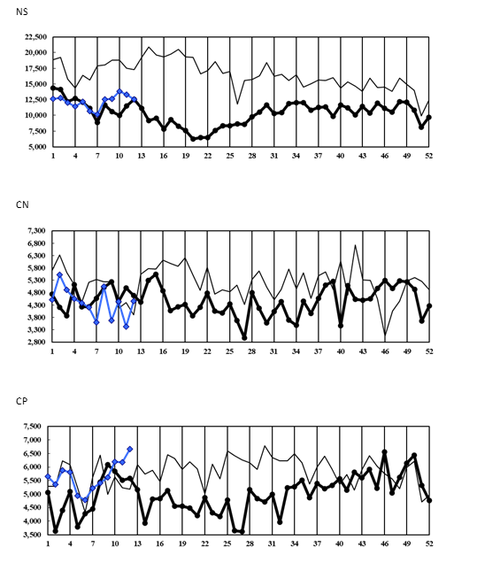
Morgan Stanley rail data – total carloads and coal loadings by RR

Slide 7
Effects of Covid on Utilities
NCTA OTP survey observations
Inconsistency for both shippers and rail carriers during 2020 – some rail service improved, some declined, and some remained unchanged
Comments from shippers
“projected ETAs are continuing to slip”
“train bunching issues and combination trains with 300 cars arriving at once”
“we never know when RR crew will show up to pick up empty train after released from the plant – sometimes up to 24 hours later”
“add a metric for when shipper requests RR to move/pick up train set and/or cars – RR may take 3+ weeks to pull an empty train”
Modifications may be made to the survey to capture more real time data for shippers

Slide 8
Utility Segment Update
Anecdotal information suggests that the effect of the pandemic has been different for utilities
Regional differences in rail service
Regional differences in electricity demand shift
Overlap of other contributing factors such as gas prices, weather events and PSR

