Slide 1
Utility Update
Rail Energy Transportation Advisory Committee
November 16, 2021

Slide 2
Utility Perspective
Inventory Updates / Challenges
Railroad Challenges / Affects
On Time Performance Survey / Concerns

Slide 3
Inventory Updates

Slide 4
Inventory Updates
Utilities are experiencing a wide array of service problems and concerns in various regions across the country, to include:
Parked train sets
Crew shortages
Increased cycle times
Missed Monthly Nominations
Doubling of train sets
Inventories are below desired levels
Many utilities implementing coal curtailments / adjustments in dispatch order to ensure supply for the Winter

Slide 5
Inventory Challenges
Total days of inventory continue to decrease in a period with inventory should be building for the Winter burn
Graph represents average burn and likely understates some utility stockpiles
Source: 2021 Energy Venture Analysis- Coal Stockpile Report September 2021

Slide 6
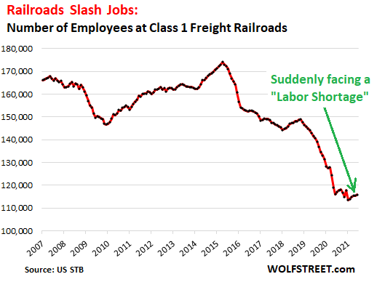
Railroad Challenges
Class 1 Railroads have cut their work forces by 33% over the past 6 years with 28% of those cuts occurring before the pandemic
Hiring during the pandemic has proven to be a challenge
Sources:
https://olywip.org/labor-shortage-for-railroads-that-have-slashed-workforce-by-33/
https://wolfstreet.com/2021/07/22/after-slashing-33-of-their-workers-in-six-years-railroads-complain-about-labor-shortages-amid-uproar-from-shippers-over-slow-shipments/

Slide 7
Railroad Challenges
Hiring continues to be an issue on the crew side and has been relatively flat or has declined over the period
Sources:
STB Class one Railroad Data

Slide 8
NCTA/FRCA/NRECA On Time Performance Survey Jan-June 2021
NCTA/FRCA/NRECA: OTP Survey Data Collected since Aug 2019 to June 2021 – 6 month periods
14 Utilities Reported Shipper Perspective Railroad Performance Data
Round Trip Transit Time (Mine to Plant) Reported Above or Below Plant Forecast
Monthly Nominations Fulfilled by Carriers: Yes/No
Railroads Serving Plants Reported:
BNSF 48%, UPRR 27% , Multi-RR 21%, NS 4%
Four Coal Supply Regions - Mine Sources Reported:
SPRB 72%, Rockies 14%, NAPP 7% , NPRB 7%

Slide 9
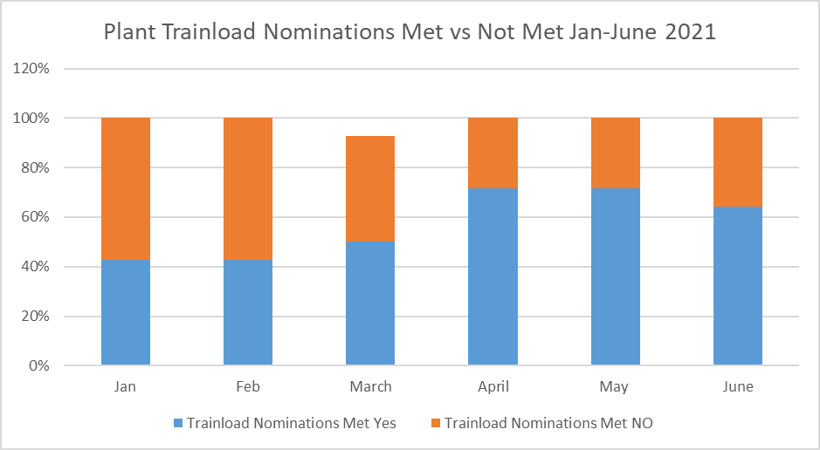
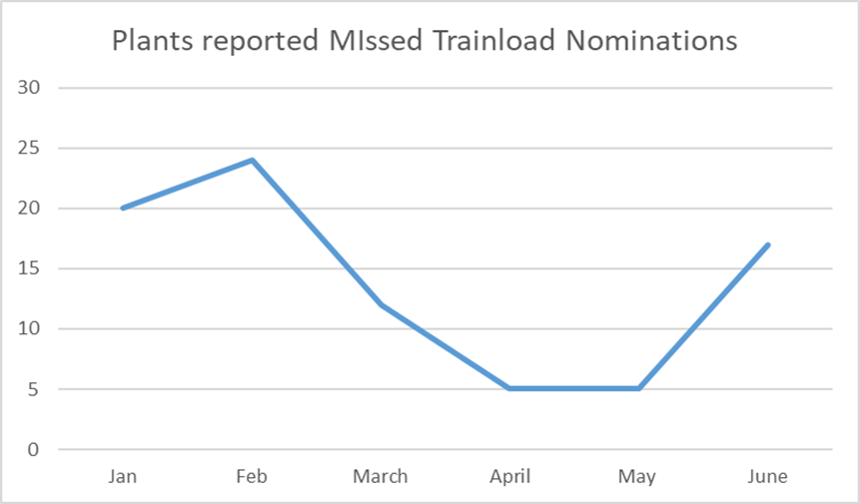
NCTA/FRCA/NRECA On Time Performance Shipper Survey: Jan-June 2021 Trainload Monthly Nominations Met vs Not Met

Slide 10
Shipper Quotes and Concerns
“Lack of Crews – Lack of Locomotive Power – Delayed Train Pick-ups – Slow cycles times”
“Trains being doubled without shipper notification”
“Inconsistent and Unpredictable Cycle Times”
“Delays with Unloading Trains – Long Delays often during Holiday weekends”
“Poor Communication from Railroads and between Railroads at Interchanges”
“Accessorial Billings that had to be disputed”
“Delayed Pulling of Empty Trains from Plant”

Slide 11
Questions / Discussion

