Slide 2
Annual Utility Inventory Survey Why Change it?
Environmental and market factors have resulted in less coal consumption
Coal industry consolidating
Less equipment being used
Shipments becoming more seasonal
Challenges for both carriers and shippers to maintain efficiencies
Transit time service metrics are a value as:
Benchmark data
Logistics and planning tool for shippers
Educational metrics for STB – RETAC and RSTAC
Reference in dialogue regarding PSR and Rulemakings

Slide 3
NCTA/FRCA/NRECA Utility Members On Time Performance Survey Data
Allied shipper groups with overlapping utility members
Survey Represents 22 Plants
Five Coal Supply Regions
Class I Railroads, Multi Line & Shortline Movements
Mine to plant transit time by railroad and coal mine source with one-way miles
August 2019- July 2020 – Round Trip Transit Time Data
Forecasting methods – In House or Railroad Forecast
Voluntary participation - Utility member identity confidential

Slide 4
How do Shippers Forecast Transit Time?
Many Factors involved in developing transit time forecast:
Inventory size, coal tonnage needed to serve load, energy load forecast
Seasonal operational considerations
Number of Train Sets/Cars – Type of cars
Railcar Maintenance Planning – Plant Outages
Dumping Operations at Utility, Staging and Placement of trains
Free time for unloading and loading –hours, days…
Geographic location of plant and miles from the mine source
Single Railroad – Multi RR
Round trip transit time forecast – In House or Railroad?
Adjustment of the forecast - How often and why?

Slide 5
Shippers Reported Forecast Methods
Round Trip Transit Time Calculated – How is it done?
Mine Source Manifest: Train Empty/Load - Arrival/Release Date Time Stamp
Plant: Train Load/Empty - Arrival/Release Date Time Stamp
Actual Hours = Days Train is in Transit: “Round Trip” per shipment
Forecast – does it include Loading and Unloading Free Time Hours?
10% Included 90% Excluded
85% In House 15% Railroad
How often does the shipper adjust the forecast?
9% Annually 52% Monthly 4% Weekly 35% Keep Same

Slide 6
Railroads Serving Plants as Reported

Slide 7
Sources As Reported

Slide 8
22 Shippers Reported Average Annual Transit Time

Slide 9
Shipper Quotes: Observations and Concerns
“Performance time has improved with 2020 YTD cycle time mostly equal to forecast average”
“We never know when RR crew will show up to pickup empty - Can be 2-4 hours after empty train release”
“Projected ETAs are continuously slipping”
“Train bunching issues” and “Combination Trains” with 300 cars arriving at once!

Slide 10
Thank you

Slide 11
Shipper Response Detail Appendix
The following slides (12-22) represent the data collected from the 22 Plants that responded to the survey
Each chart includes data reported for each plant:
Blue columns represent the average round trip transit time days per month
Orange columns represent the forecast transit time days used for planning each month’s shipments
Source (mine) region, serving railroad and one-way-miles from source to plant

Slide 12
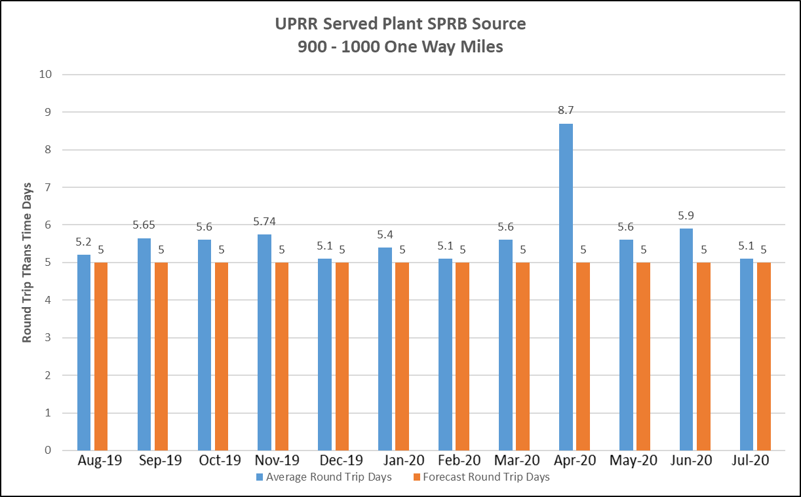
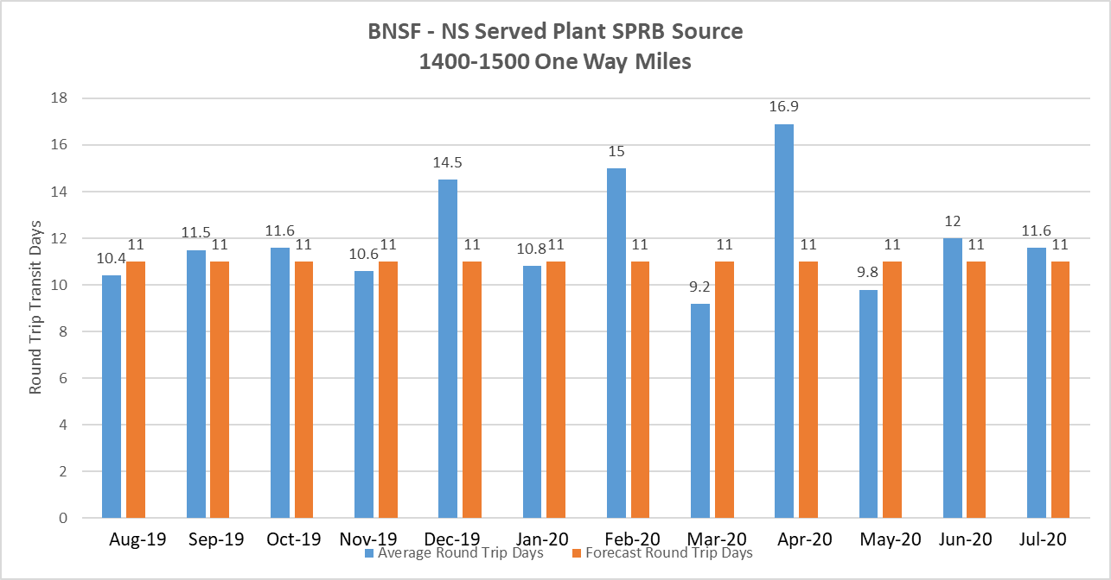

Slide 13
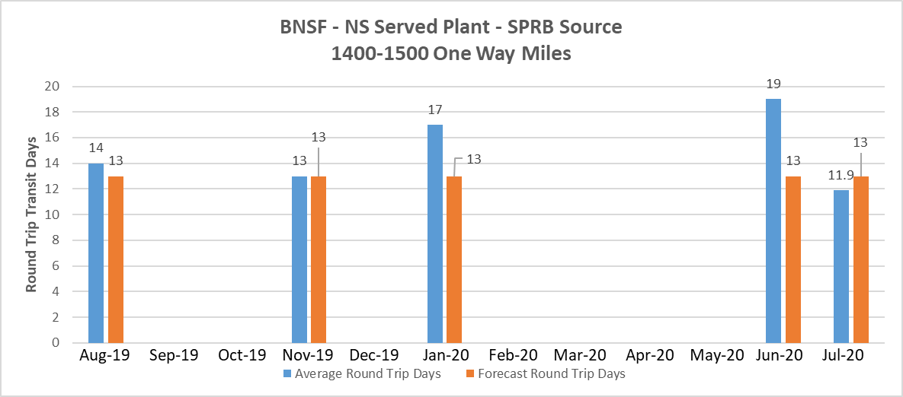

Slide 14
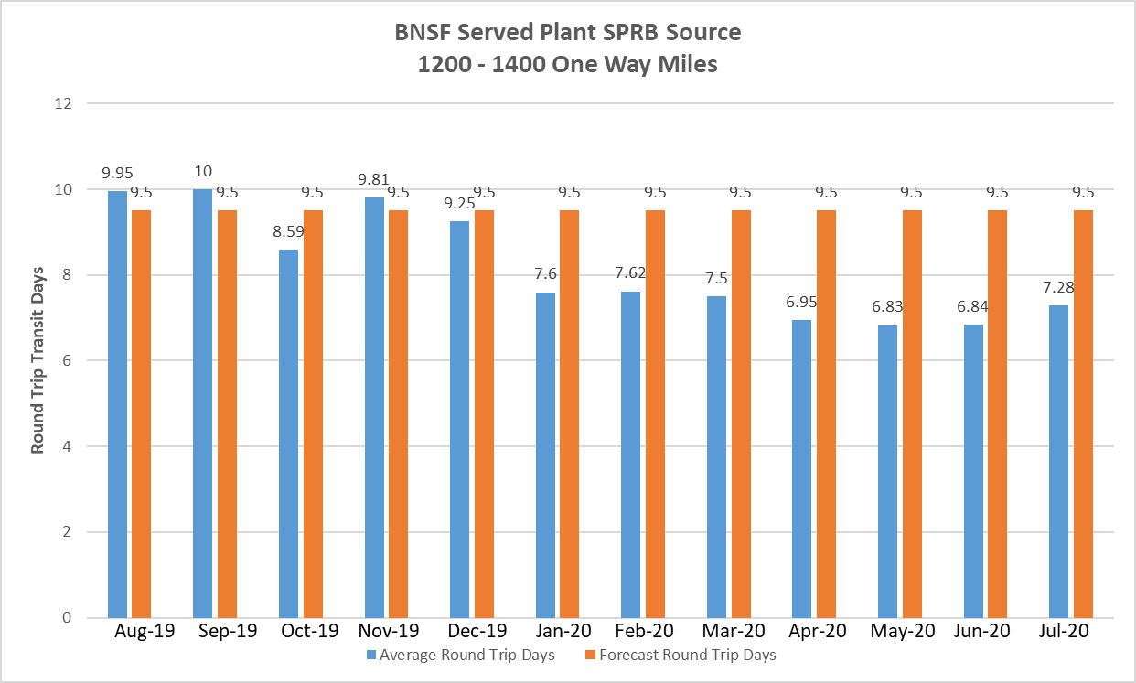

Slide 15
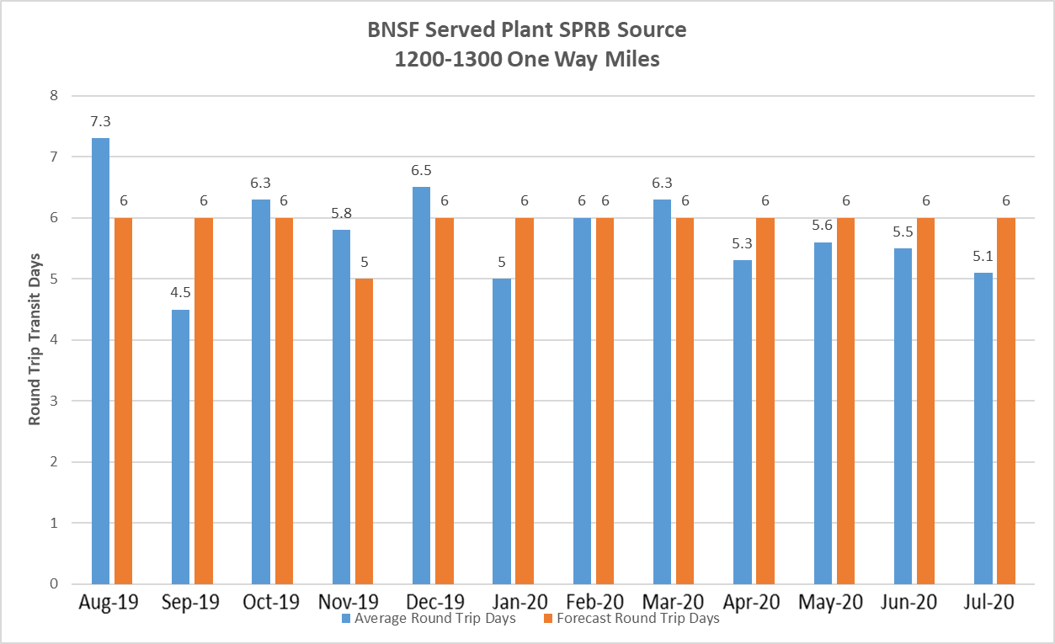

Slide 16
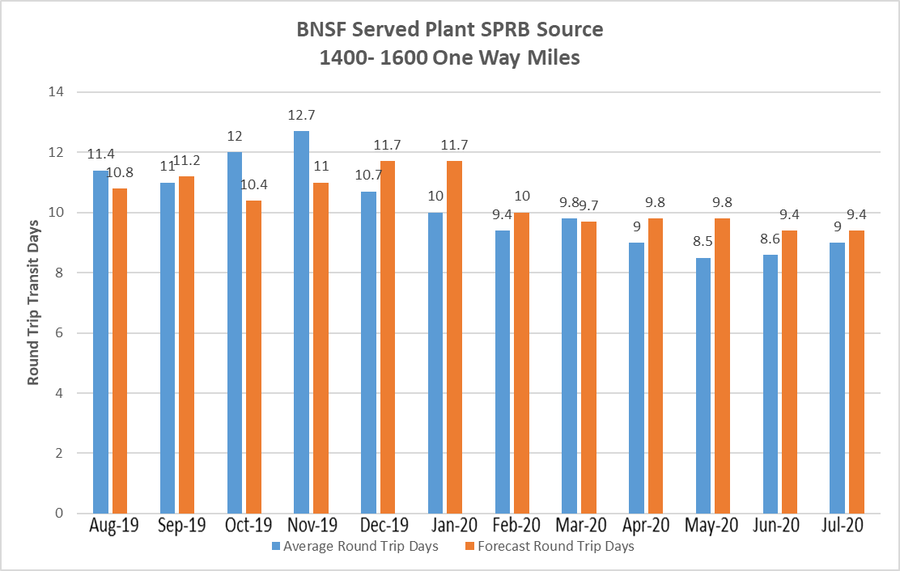

Slide 17
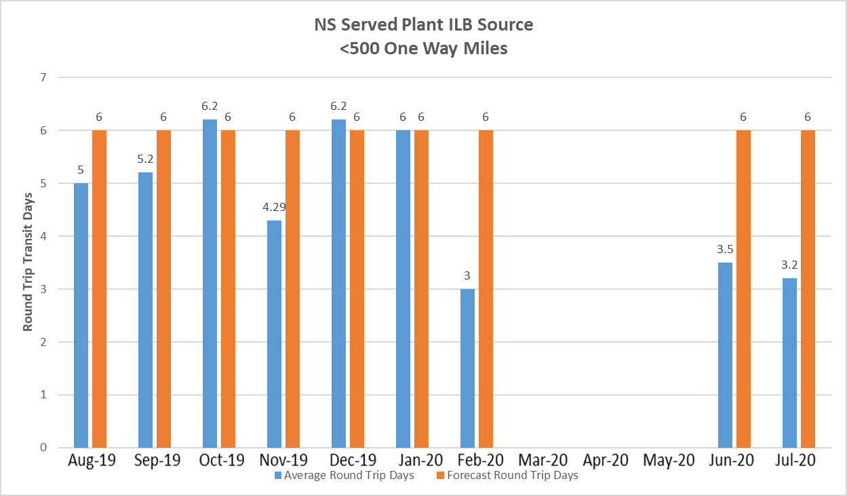
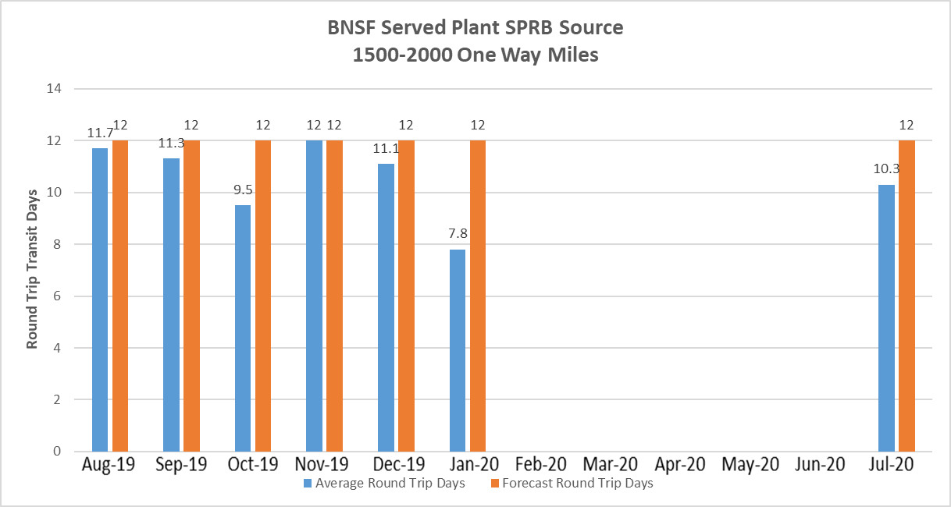

Slide 19
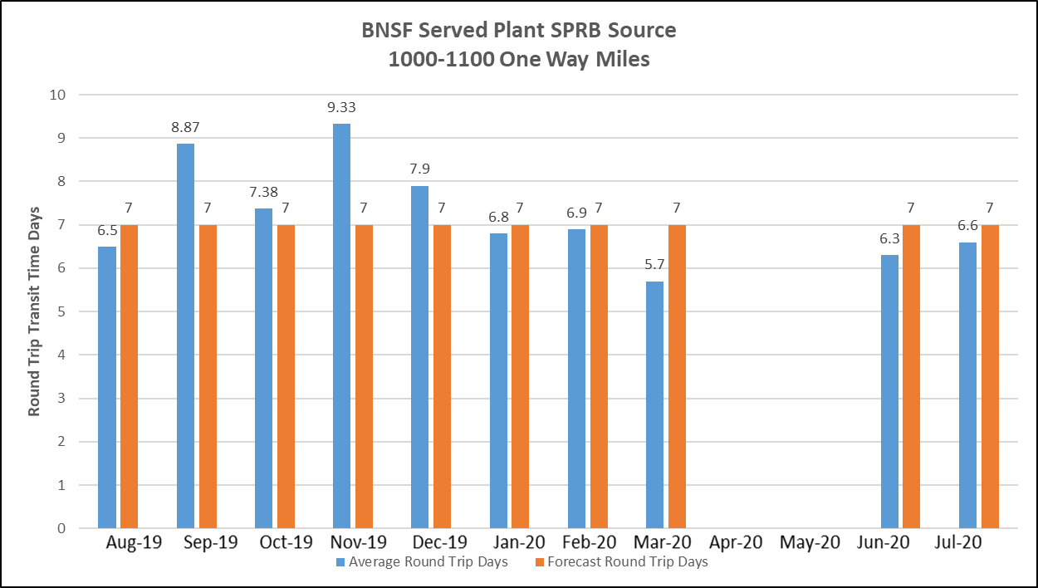

Slide 20
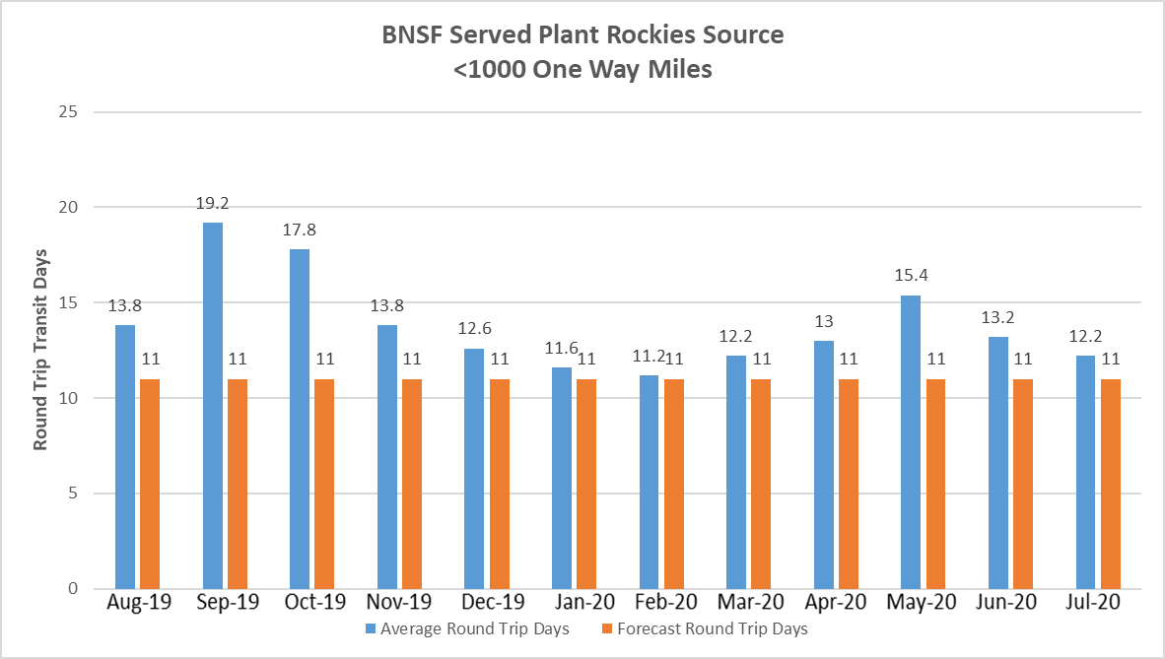

Slide 21
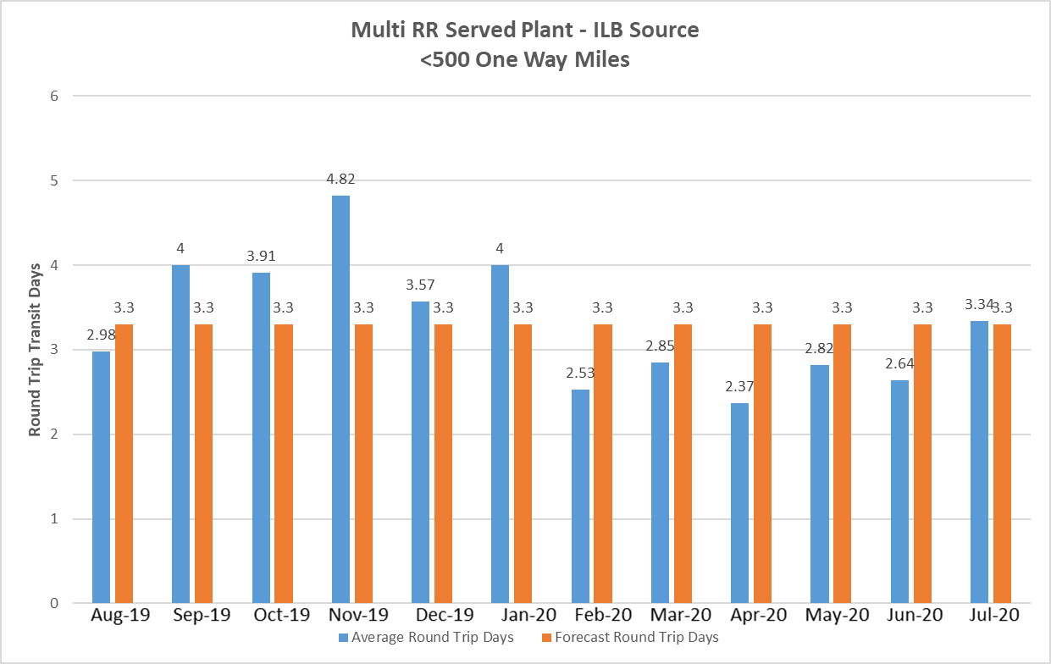

Slide 22
