Slide 1
Meeting of the
Rail Energy Transportation Advisory Committee
October 26, 2022
RETAC
October 26, 2022
1

Slide 2
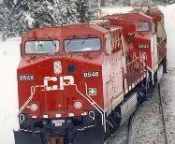
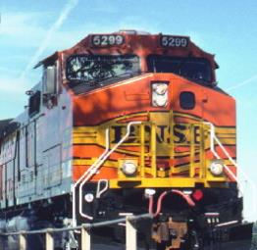
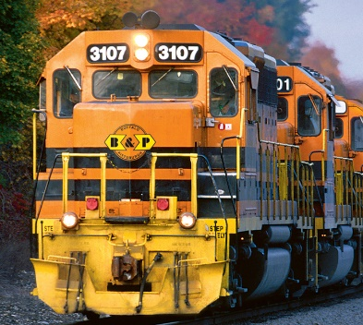
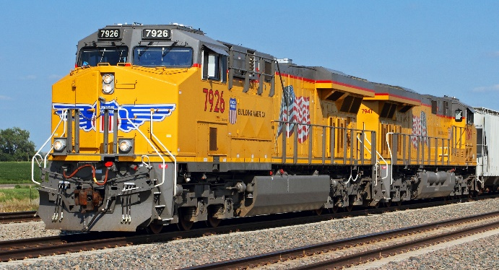
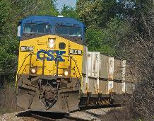
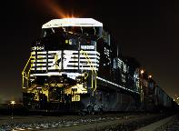
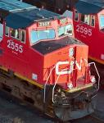
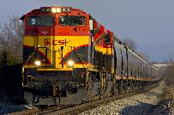
Topics for Today
• Overall rail traffic trends
• Coal
• Other energy-related products
• Service
• Collective bargaining update
• Questions
\\aarfs2\Communications\CONTENT INVENTORY\Photos & B-roll\Locomotives\\\aarfs2\Communications\CONTENT INVENTORY\Photos & B-roll\Locomotives
\\aarfs2\Communications\CONTENT INVENTORY\Photos & B-roll\Locomotives\Additional\bnsfBEST
Photo courtesy of Genesee & Wyoming
\\aarfs2\Communications\CONTENT INVENTORY\Photos & B-roll\Locomotives\UP-Train
\\aarfs2\Communications\CONTENT INVENTORY\Photos & B-roll\Locomotives\CSX-Locomotive-Trees
\\aarfs2\Communications\CONTENT INVENTORY\Photos & B-roll\Locomotives\CN-Locomotives
\aarfs2\Communications\CONTENT INVENTORY\Photos & B-roll\Locomotives\NS-Train-Night
\\aarfs2\Communications\CONTENT INVENTORY\Photos & B-roll\Locomotives\KCS-Grain-Train
RETAC
October 26, 2022
2
Notes:
Chairman Oberman; Vice Chairman Primus; Commissioners Hedlund, Fuchs, and Schultz; and fellow members of RETAC, good morning. It’s a pleasure to be able to meet in person again with all of you to talk about the vital topic of energy transportation.
In my presentation today, I will first say a few words about overall rail traffic trends, followed by a discussion of current trends related to the rail transportation of coal.
Next I will discuss crude oil and ethanol. After that, I will then discuss something that has received - rightfully so - an enormous amount of attention lately: rail service. I’ll follow that with a brief update on rail labor negotiations.
I’ll be happy to answer any questions before turning the floor over to individual railroads to offer their own comments.

Slide 3
Total U.S. Rail Carloads
(6-week moving average)
YTD* 2022 vs:
YTD* 2021: ↑ 0.1%
YTD* 2020: ↑ 7.9%
*Through week 41. Data are originations, do not include intermodal, and do not include the U.S. operations of CN, CP, and GMXT. Source: AAR Rail Time Indicators
RETAC
October 26, 2022
3
Notes:
Based on data collected by the AAR, for the first nine months of 2022, total U.S. carloads were basically flat over the same period in 2021 and up 8.0% over the same period in 2020.

Slide 4
RETAC
October 26, 2022
4
Notes:
So far this year, 8 of the 20 carload categories the AAR tracks have had year-over-year carload gains, led by coal, crushed stone and sand (this category includes frac sand); and chemicals.
Chemical carloads were extremely high in the first part of this year, but have fallen off over the past few months. Ethanol is the single highest-volume chemical carried by U.S. railroads.
Commodities with carload declines this year through September include petroleum and petroleum products (which includes crude oil, LPGs, and many other commodities), and grain, carloads of which are down this year largely because U.S. grain exports are down.

Slide 5
U.S. Rail Intermodal
(6-week moving average)
YTD* 2022 vs:
YTD* 2021: ↓ 5.0%
YTD* 2020: ↑4.9%
*Through week 40. Data are originations and do not include the U.S. operations of CN, CP, and GMXT. Source: AAR Rail Time Indicators
RETAC
October 26, 2022
5
Notes:
On the intermodal side, volumes this year through September were 10.3 million containers and trailers. That’s the fourth most ever for January to September but down about 5% from the same period in 2021.
Intermodal volumes are being constrained by a shift in consumer spending away from goods and towards services; high inventories at many retailers that reduce the need for restocking; and high inflation that means the same amount of money spent means a smaller quantity of goods purchased.
In addition, there are continuing problems regarding the availability of warehouse space, dray truckers, and chassis. As we discussed at the last RETAC meeting in April, railroads are just one part of a global supply chain. All parties must do their part or the entire logistical chain suffers.

Slide 6
Rail Carloads of Coal
(millions)
Data are originations for Class I railroads. Source: AAR Freight Commodity Statistics
RETAC
October 26, 2022
6
Notes:
As all of you know, coal carloads have been on a downward trend for many years. 2021 saw a small reversal. Originated Class I carloads of coal rose to 3.3 million in 2021, up 10% from 2020’s 3.0 million carloads. Railroads were able to respond to market needs.

Slide 7
U.S. Rail Carloads of Coal
(6-week moving average)
YTD* 2022 vs:
YTD* 2021: ↑ 3.6%
YTD* 2020: ↑ 15.0%
*Through week 41. Data are originations, do not include intermodal, and do not include the U.S. operations of CN, CP, and GMXT. Source: AAR Rail Time Indicators
RETAC
October 26, 2022
7
Notes:
So far this year, coal carloads have risen modestly. For 2022 through week 41, they were up 3.6% over the same period in 2021 and up 15% over the same period in 2020.

Slide 8
U.S. Rail Carloads of Coal
vs. U.S. Electricity From Coal
2016 2017 2018 2019 2020 2021 2022
*3-month moving average, million megawatthours.
**3-month moving average based on weekly originations. Source: EIA, AAR
RETAC
October 26, 2022
8
Notes:
Electricity generation is by far the largest driver behind coal consumption in the United States, and historically there’s been a very close correlation between rail coal volumes and the amount of electricity generated by coal.

Slide 9
Decline in Coal Share of
U.S. Electricity Generation
RETAC
October 26, 2022
Notes:
According to the Energy Information Administration, coal’s share of U.S. electricity generation rose to 22% in 2021 from 19% in 2020, but so far in 2022 the coal share is back down to 20%.
Railroads accounted for 69% of coal deliveries to coal-fired power plants, according to EIA data. That means that, today, the share of U.S. electricity generation by coal delivered by rail is around 14-15%.
Put another way, today, approximately 85% of U.S. electricity generation does not directly involve railroads. This is probably the clearest real-world example of the intense competitive constraints imposed on railroads by product competition.

Slide 10
Natural Gas Prices Have Surged*
(dollars per million BTU)
2017 2018 2019 2020 2021 2022
*Henry Hub spot price. Source: Energy Information Administration
RETAC
October 26, 2022
10
Notes:
The war in Ukraine has inflicted an unimaginable direct human cost on innocent people, but the war’s impact is being felt indirectly all over the world as well. One example is in oil and natural gas markets. Russia is a major oil and gas producer, accounting before the war for some 40% of European natural gas consumption. The desire to replace Russian supplies has meant sharply higher global natural gas prices.
I made this point at our last meeting in April, but it bears repeating. There are risks associated with the strategy that many utilities have adapted to shift away from coal to natural gas. With sharply higher natural gas prices today, many utilities are seeking additional coal, but coal production cannot be turned on and off like a light switch.
Scores of coal mines have closed in recent years because their customers have shed a tremendous amount of coal-fired capacity. Many coal mines that remain today have reduced their investments and productive capacity. Thousands of miners have left the industry in recent years. Railroad acknowledge that service quality today is not always what their customers want, but even if rail service were perfect today, utilities would still be having difficulty obtaining all the coal they want, simply because of the shrinkage of the U.S. coal industry and the severe broad logistical and labor market challenges facing all industries today. This also means coal is unable to be a “check” on natural gas prices as effectively as it once was.

Slide 11
Year-Over-Year U.S. Coal Exports Up Slightly
(millions of tons)
2016 2017 2018 2019 2020 2021 2022
*January to July. Source: Energy Information Administration
RETAC
October 26, 2022
11
Notes:
U.S. coal exports rose sharply in 2021 from 2020, but so far this year they are up only slightly from last year. Railroads are responsible for moving much of the coal that arrives at U.S. ports for export.
Exports are equivalent to 13% to 15% of U.S. coal production in a typical year and include a roughly equal mix between metallurgical and steam coal. Many overseas coal consumers are facing many of the same constraints that U.S. coal consumes are facing, especially constraints related to the environmental impact of consuming coal.

Slide 12
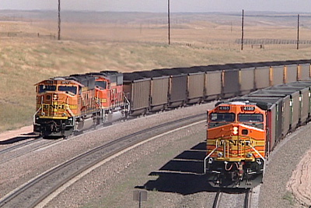
Future Challenges Remain
“Our Utilities team forecasts that 48GW of coal-fired capacity will be retired over the next 5 years, up 6% from our analysis a year ago. This represents 23% of current coal capacity in the U.S. and a new peak in our 10 years of conducting this analysis.
Wolfe Research Sept. 2022
RETAC
October 26, 2022
Notes:
All of us here know that the coal market has changed tremendously over the past decade. As the quote on this slide makes clear, coal will continue to face significant challenges. Everyone associated with coal production, consumption, and transportation has to deal with this reality as best they can.
That said, coal is not going to disappear from the railroads anytime soon. So far this year, coal accounts for 29% of non-intermodal U.S. rail volume. Railroads will continue to do their best to provide safe, reliable, and cost-effective service to their coal customers for as long as coal moves by rail.

Slide 13
Oil Prices Have Surged…
(WTI, $ per barrel )
2016 2017 2018 2019 2020 2021 2022
RETAC
October 26, 2022
Source: Energy Information Administration
13
Notes:
Turning now to crude oil, thanks largely to the war in Ukraine and to production ceilings implemented by OPEC, oil prices have surged over the past year.

Slide 14
…But U.S. Crude Oil Production Has Not
(million barrels per day)
2016 2017 2018 2019 2020 2021 2022
Source: Energy Information Administration
RETAC
October 26, 2022
14
Notes:
When the price of something goes up, producers will often raise their output. As this slide shows, that hasn’t happened with crude oil. U.S. crude oil output has been basically flat for the past two years.
Reasons for this include a desire by capital markets to instill more discipline into the market, as well as actions taken by policymakers that have made it more difficult for domestic oil producers to raise output. Today, in many cases oil producers are disincentivized from making costly long-term investments in their operations. As a result, capacity is not what it could be and consumers are paying more for energy than they otherwise would.
I respectfully suggest there may be a lesson here regarding railroads. Board members should be careful to refrain from taking actions that, however well intended, inadvertently impede the ability of railroads to be responsive to customer needs and that make it more difficult for railroads to be able to make the investments they need to ensure railroads’ ability to meet our economy’s transportation needs.

Slide 15
Which Helps Explain Recent Flat
Crude Oil Shipments by Rail
(million barrels)
2016 2017 2018 2019 2020 2021 2022
Source: Energy Information Administration
RETAC
October 26, 2022
15
Notes:
U.S. rail shipments of crude oil and been trending down for the past couple of years thanks for marketplace changes and competition from pipelines.
Today, roughly equal amounts of crude oil carried by U.S. railroads originate in the United States and in Canada. Most of the U.S. originations originate in North Dakota; much of that today is shipped to the West Coast.

Slide 16
U.S. Ethanol Shipments by Rail
(million barrels)
2016 2017 2018 2019 2020 2021 2022
Source: Energy Information Administration
RETAC
October 26, 2022
16
Notes:
Turning now to ethanol, this chart shows that, according to EIA data, rail carloads of ethanol have fluctuated, with a few exceptions, within a fairly narrow band in recent years.
Ethanol is the highest-volume single chemical transported by rail in the United States, with volumes of around 20 million barrels in a typical month. That’s equivalent to 26,000 to 27,000 carloads per month, or over 300,000 carloads per year.

Slide 17
Gains in Freight Rail Employment
Total employment ↑ 5.2% since Jan. 2022
Train & engine ↑ 7.4% since Jan. 2022
2021 2022
RETAC
October 26, 2022
Source: STB
Notes:
Turning now to service, let me be clear: Railroads know that, for many of their customers, including many coal and other energy-related customers, rail service this past year has not been what it should be.
Frankly, it is not in a railroad’s best interest to provide poor service, and railroads know that poor service is not a recipe for growth. Railroads fully recognize there are continued service delivery issues and they are working extremely hard to ameliorate them.
Good service starts with having enough people. Railroads greatly appreciate the skill and professionalism of their employees and railroads are taking a number of steps to get more of them. Unfortunately, railroads — like firms in virtually every industry — are having difficulty attracting and retaining enough qualified employees. The labor market today is as tight as it’s ever been.
Railroads may not be adding to their employee ranks as quickly as they’d like, but they are making progress. Since January of this year, total Class I employment is up 4.7%, or 5,260 employees. Train and engine employment is up 7.4%, or 3,406 employees. Is that enough? No, which is why railroads are continuing to find ways to grow their employment counts. Railroads are optimistic that employment numbers for the months ahead will show continued growth.

Slide 18
RETAC
October 26, 2022
18
Notes:
The Board’s recent service-related decisions require railroads to report extensive data on service and employment. Like rail employment, rail service metrics in recent months have been trending in the right direction.
Looking just at coal trains, since we last met in April, average speed for coal trains has been trending higher.

Slide 19
Collective Bargaining Update
RETAC
October 26, 2022
Notes:
All of us here know that the coal market has changed tremendously over the past decade, for reasons based on economics (especially the increased production and, until recently, lower price of natural gas) and for environmental reasons.
And as the quote on this page makes clear, coal will continue to face significant challenges. Everyone associated with coal production, consumption, and transportation has to deal with these new realities as best they can. For railroads, that will mean continuing to do their best to provide safe, reliable, and cost-effective service to their coal customers.
And coal is not going away anytime soon. So far this year, coal accounts for approximately

