Slide 1
Utility Update
Rail Energy Transportation Advisory Committee
October 26, 2022
Bette Whalen – Lower Colorado River Authority

Slide 2
Utility Perspective
Inventory Updates / Challenges
On Time Performance Survey / Concerns
Key Takeaways / Asks

Slide 3
Inventory Challenges
The percentage of Utilities with days of inventory of 30 days
or less has not improved YTD.
Source: 2022 Energy Venture Analysis- Coal Stockpile Report September 2022

Slide 4
NCTA/FRCA/NRECA On Time Performance Survey Jan – June 2022
NCTA/FRCA/NRECA: OTP Survey Data Collected since Aug 2019 to June 2022 in 6-month periods
45 Plants Reported Shipper Perspective Railroad Performance Data
100% reported their company had to modify operations due to RR service issues (was 64% last survey)
87% reported Rail Service worse than it was in 2021 and/or last 3 years (was 60% last survey)
Railroads Serving Plants Reported:
BNSF, UPRR, NS, Multi-RR, and Short line movements
Six Coal Supply Regions - Mine Sources Reported:
SPRB, NPRB, Rockies, NAPP, ILB, NAPP, CAPP

Slide 5
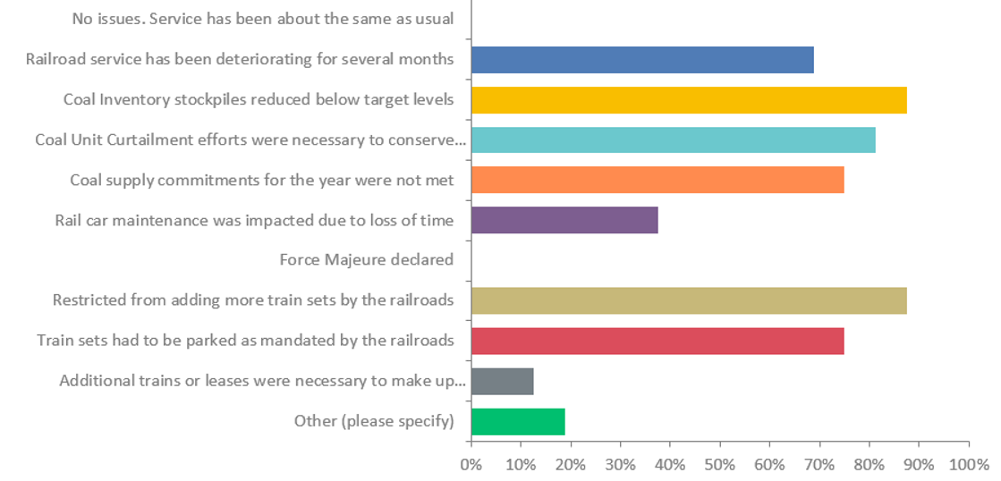
In what way have your operations been impacted by railroad service issues? Check all that apply: 45 plants responded

Slide 6
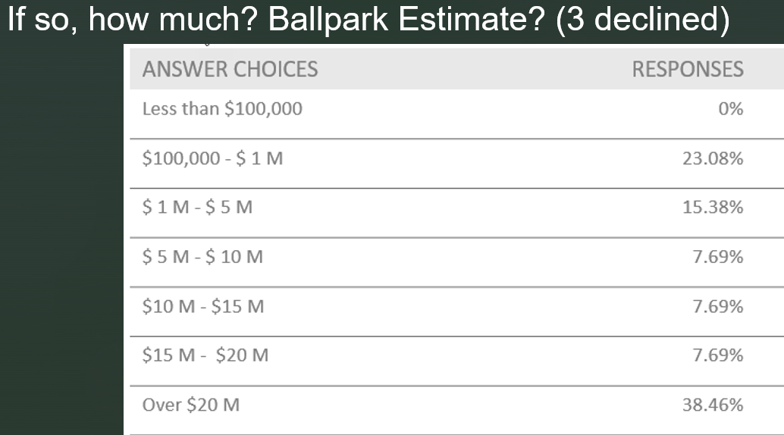
Have railroad services issues caused an increase in costs for your company? Yes: 87.50% No: 12.50%

Slide 7
What kind of railroad service issues have you experienced? Check all that apply

Slide 8
How does average monthly service compare with plant forecast? 45 plants responded

Slide 9
Key Takeaways and Asks
Utility forecasting for coal deliveries involves great deal of planning
Forecasts typically allow for some flexibility in deliveries
Utility stockpiles afford some cushion to allow for coal deliveries and burn forecasts/actuals
Coal deliveries trending 20-30% below monthly nominations which is concerning
Low stockpiles
Coal conservation and unit curtailment
Asks:
Better communication from RRs in meeting shipper forecasts and missed permits
Updates on crew availability

Slide 10
Questions / Discussion

