Slide 1

Surface Transportation Board
Update
Southwest Association
of Rail Shippers
Commissioner Francis P. Mulvey
February 28, 2013

Slide 2
STB Basics
Independent economic regulatory agency for the railroad industry
Jurisdiction over
  Railroad rate and service disputes
  Railroad mergers and acquisitions
  Rail line abandonments and construction
  Freight/passenger rail relationships
  Limited jurisdiction over other modes

Slide 3
Board Members
Comprised of 3 Board members
All members have rail transportation backgrounds
Elliott (D)
United Transportation Union
Begeman (R)
Senate Commerce Committee
Mulvey (D)
House T&I
DOT IG for rail
GAO transp. group

Slide 4
STB STAFF
Professional staff
  Lawyers, economists, financial analysts, environmental and operational specialists
Diverse backgrounds
#1 small agency - annual federal
employee survey 4 years in a row

Slide 5
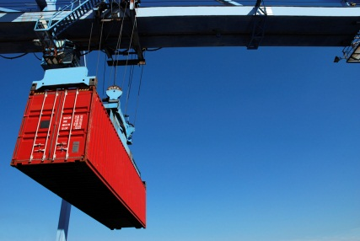
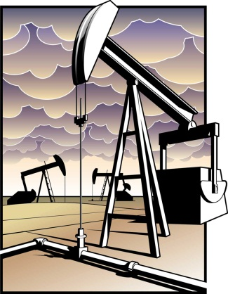
General Rail Industry Trends
  Mixed traffic volumes
    Intermodal growth
    Motor vehicles up
    Coal down
  Petroleum boom
    Frac sand movements
    Oil movements via rail
    Natural gas growth impacts

Slide 6


Agricultural Rail Issues
Largely flat grain rail volumes
New traffic patterns emerging
  Energy policy, ethanol
Increased Globalization
  Domestic impacts from Russia, South America, Australia
Longer trains, shuttle service, fewer loading points

Slide 7
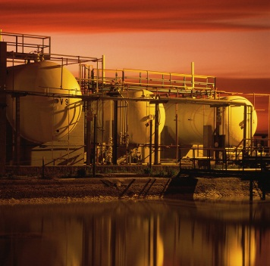
Chemical Rail Issues
Rise in STB matters involving chemical industry
Non-rate cases
  PTC cost reporting
  TIH liability
3 pending chemical rate cases; 1 recently settled

Slide 8
Chemical Rail Issues
Cases raise complex & novel issues, including market dominance
Messaging from AAR & ACC at
  STB
  U.S. Congress, state legislatures
  Public
STB encourages private sector solutions where possible

Slide 9
Rail Rates Issues
Post-Staggers productivity gains were passed on to shippers via lower rates; studies show this has ended
  Not all markets have competitive options
  Fewer long-term contracts
Rail is capital intensive industry
  Capex $5.8B (2003)
  $13B (2013 planned)
  New yards, double-tracking, intermodal facilities

Slide 10
Rail Rate Issues
Always a major area of contention
STB mission
  Protect captive shippers from monopoly abuses
  Permit railroads to earn sufficient revenues
Balance key to STB dispute resolution
Broad review of competition & rate issues underway

Slide 11
Rail Rate Case Changes
Filing fees lowered
Major changes to rate case process in 2007
  Improve process
  Reduce costs
Introduction of small/medium rate case procedures
Changes to cost of capital computation

Slide 12
Rail Rates Pending Issues
EP 715 - Rate Regulation Reforms
  Record recently completed
  Under Board review; expedited schedule
EP 711 – Competitive Switching
  Board seeks comments, studies
  Encourage participation
Active rate cases
  DuPont v. NS, Total v. CSXT, Sunbelt v. NS, IPA v. UP (M&G v CSXT recently settled)
  Western Fuels & AEPCO cases – decided but issues remain (e.g., impact of Berkshire/BNSF transaction, court challenge)

Slide 13
URCS Review
URCS critical to rate cases
Completed
  improved version of online interactive URCS
  major staff review of URCS processes
Pending
  Make whole adjustment rulemaking
  Montana v. BNSF complaint
  Carrier reporting changes
  Update of software from FORTRAN to modern platform

Slide 14
Practices cases pending
Various tariff-related issues include:
  Fuel surcharges challenge
  Coal dust
  Tank car routing
  Demurrage
  Clean cars
  Hazmat requirements
Increased shipper concerns regarding accessorial charges/costs
Formal service complaints less prevalent

Slide 15
STB Emergency Routing Responses
Weather impacts all regions
Updates from carriers re service maintenance efforts
Site visits to affected areas
Rapid response to petitions for emergency trackage rights
Tracking of embargo lengths and purposes

Slide 16
STB Informal Dispute Resolution
STB’s Rail Customer and Public Assistance Program (RCPA)
Expert staff, operations knowledge
Available to large & small shippers
Good record on resolving disputes
Less expensive and acrimonious

Slide 17
Congressional Agenda (Senate)
Leadership
  Chairman Rockefeller - upcoming retirement
  Ranking Member – Senator Thune
Sequester, budget issues
Fiscal cliff deal extended short line tax credit
No recent activity on STB reauthorization bill or railroad antitrust bill
PTC hazmat
  Would remove 10,000 miles from PTC mandate
  Tackle deadline issues?

Slide 18
Congressional Agenda (House)
Leadership
  New T&I Chairman Bill Shuster
  Ranking Member Rep. Nick Rahall
  New Railroad Subcommittee Chairman Rep. Jeff Denham
  Ranking Member remains Rep. Corrine Brown
Many new committee members
Agendas not yet announced

Slide 19
STB Future
Opportunity for Board to address important railroad/shipper issues
Government wide-funding issues
New STB Board member
  Holdover year expires end of 2013
  White House nomination/Senate confirmation process

Slide 20
Thank you
Any Questions?

