Slide 2
From CSXT’s Closing Brief at 27
From SECI’s Closing Brief at 6
one question for the Board, and it has nothing to do with crane design capacity or local zoning laws or environmental regulations. The question is whether water transportation is a real and viable option. The Board does not need to decide precisely how a dock would be designed or what path a conveyor might take – it need only decide whether some configuration of water transportation could work. The fact that SECI used rail-barge transportation for many years, the fact that it chose the site of SGS in part because of its access to water transportation, the fact that many other utilities in Florida rely on water transportation supply chains like that proposed in CSXT’s evidence, and the fact that nearby businesses regularly use barge transportation all speak to the viability of the barge option. Nothing more is required for the Board to find that water transportation constitutes an effective competitive option and therefore that CSXT is not market dominant.
ratio of the challenged rates to the variable cost of the issue service exceeds 180%. 49 U.S.C. § 10707 (d)(1)(A). In this case, there is no dispute that the revenue-variable cost (“r/vc”) ratios produced by the rates subject to SECI’s Complaint substantially exceed 180%.
The Board does not need to decide precisely how a dock would be designed or what path a conveyor might take – it need only decide whether some configuration of water transportation could work.
The court and agency jurisprudence concerning the matter of “qualitative” market dominance establishes certain key criteria for determining whether and to what extent a rail carrier faces “effective competition.” The basic test is whether "there are any alternatives sufficiently competitive (alone or in combination) to bring market discipline to [a railroad's] pricing.” West Texas Utilities, 1 S.T.B. at 645, quoting Metropolitan Edison, 5 I.C.C. 2d at 410. In applying this test, it is not enough to look only to whether a hypothetical – or even actual – alternative exists; it must be shown that the erstwhile competition acts as a true economic constraint on the defendant's rate ambitions:
The basic test is whether “there are any alternatives sufficiently competitive (alone or in combination) to bring market discipline to [a railroad’s] pricing.” West Texas Utilities, 1 S.T.B. at 645, quoting Metropolitan Edison, 5 I.C.C. 2d at 410.
D. CSXT Is Not Market Dominant Over Movements
Through Charleston.
Regardless of the Board’s ruling as to CSXT’s market dominance over the mine origins, there can be no question that CSXT is not market dominant over movements through Charleston. Charleston is not a mine, and coal shipments do not “originate” at the Port of Charleston. Rather, if coal or petcoke ever were transported
In its Reply Evidence, CSXT raised four (4) points of contention with respect to SECI's Opening presentation on variable costs. On Rebuttal, SECI adjusted the traffic and operating inputs in response to CSXT's first point, and demonstrated that the remaining three (3) lacked merit and should be rejected by the Board. See SECI Rebuttal at II-2-12.

Slide 3
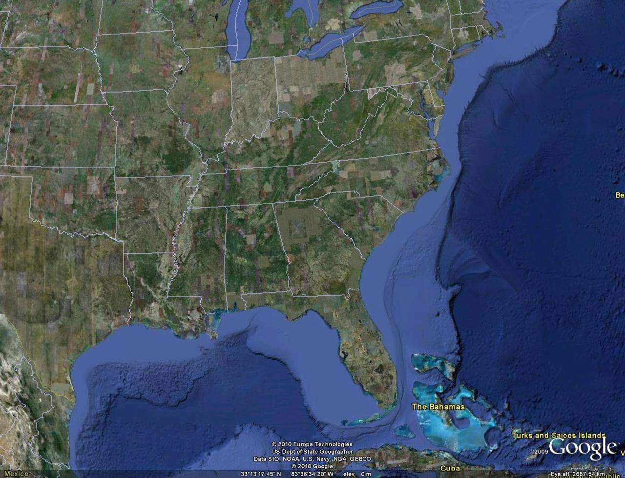
CSXT’s “Alternative” Routes Compared
To CSXT’s Existing Route
From CSXT’s Reply Exhibit II-B-2 (EVA Report) at 1-2 and SECI’s Opening Exhibit III-A-1

Slide 4
Dr. Sansom’s FPSC Testimony
Q. What is Seminole’s situation and approach?
A. Seminole has a rail-served plant at Palatka, Florida. In 2002 and 2003 Dotiki coal delivered by rail cost Seminole’s members less than Dotiki coal delivered by barge to Big Bend. This is shown in the table below and demonstrates that CSXT’s service to Palatka, which does not enjoy rail/barge competition, is more efficient and cost-effective by a wide margin for Seminole’s members than TECO’s water route to Big Bend is to TECO’s ratepayers.
. . .
Q. What, if anything, is noteworthy about this?
A. This is noteworthy because it demonstrates substantial cost savings via rail, even though Seminole is captive to the CSXT rail system and Big Bend could have rail/water competition.
From SECI’s Rebuttal Evidence at II-34

Slide 5
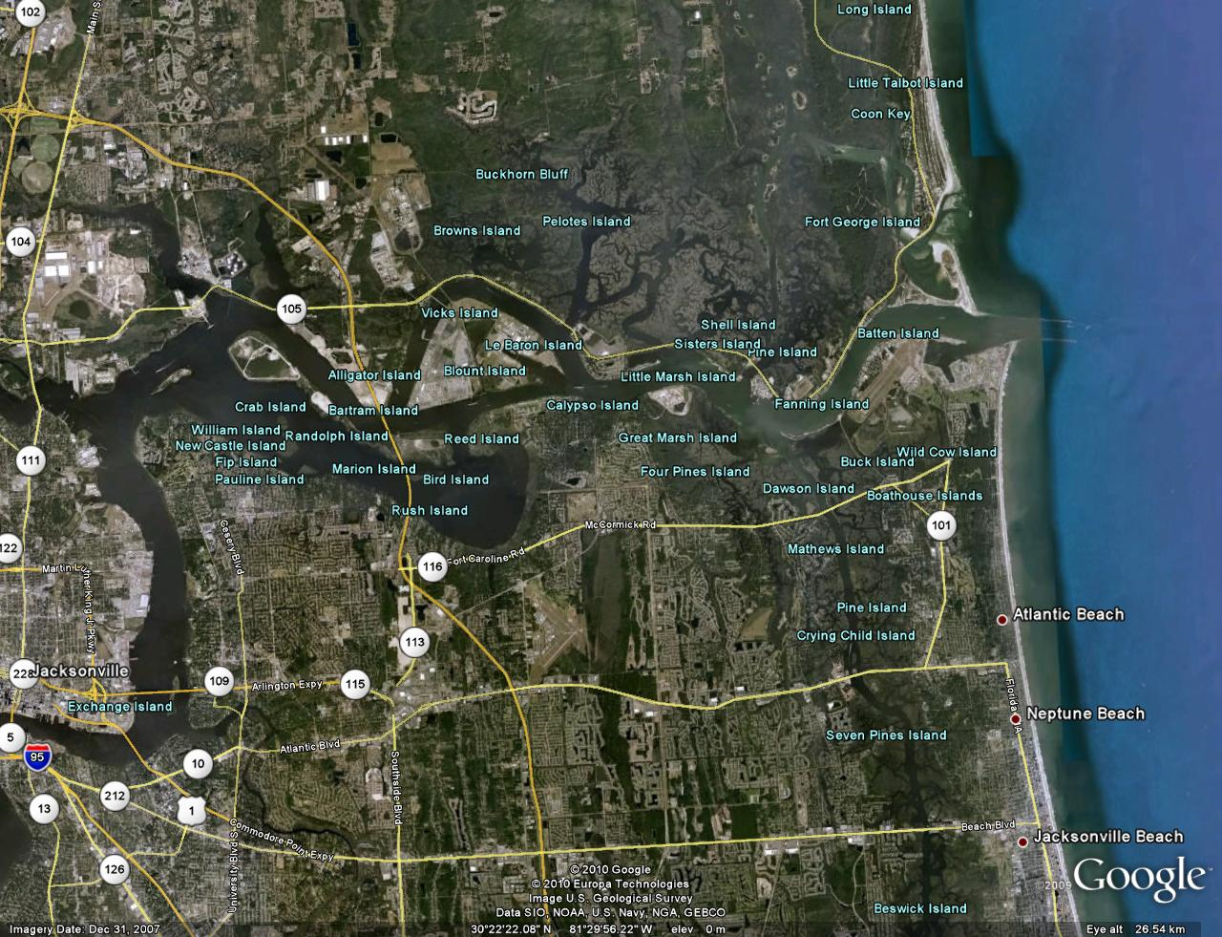
From CSXT’s Reply Exhibit II-B-2 (EVA Report) at 7-8

Slide 6
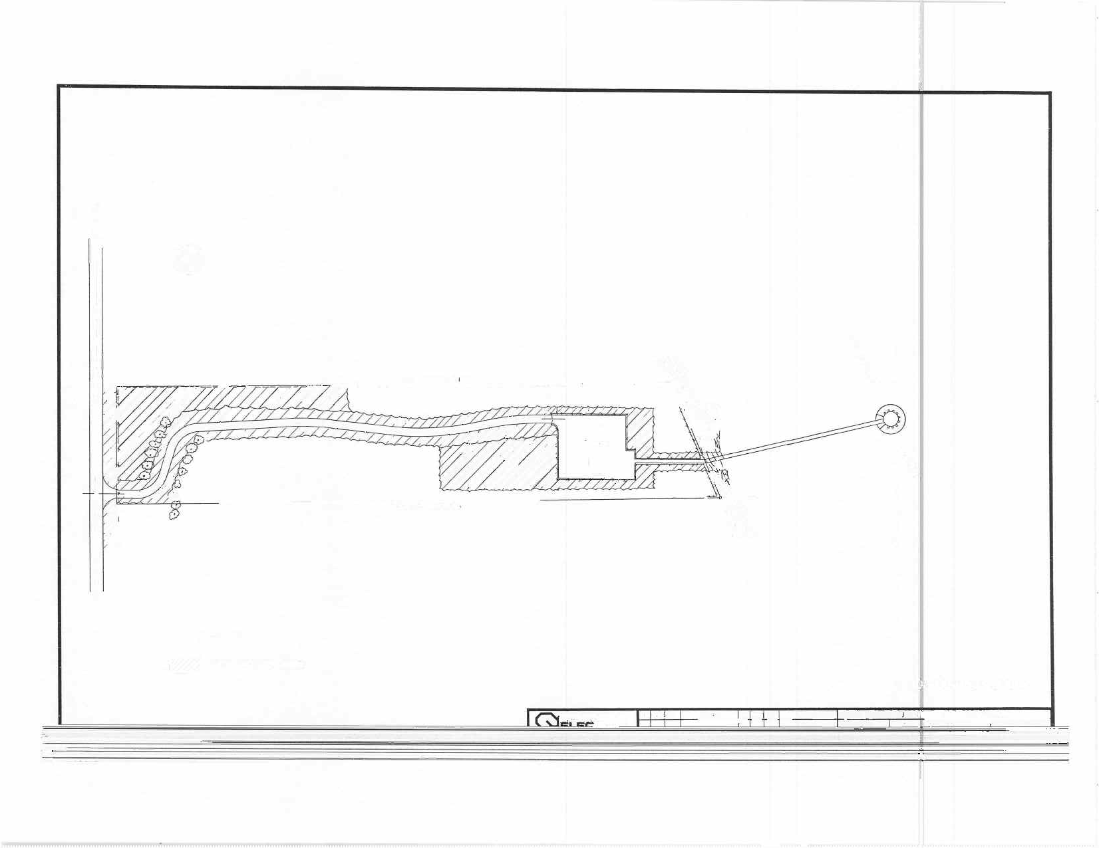
St. Johns
SECI Prop. Line
Pump
House
River
SECI Prop. Line

Slide 7
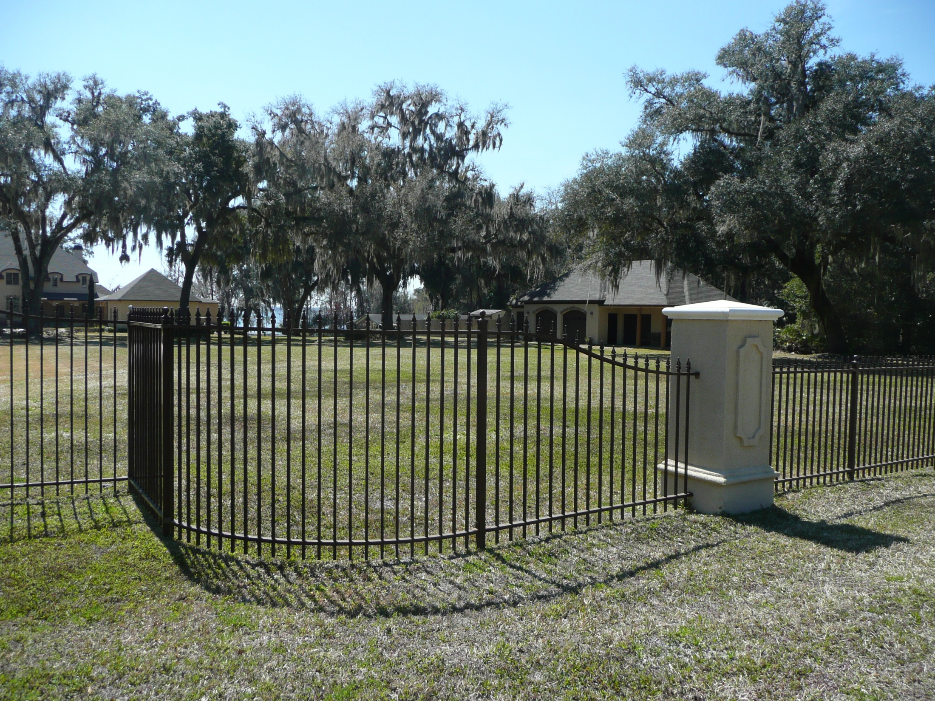
From SECI’s Rebuttal Evidence at II-48

Slide 8
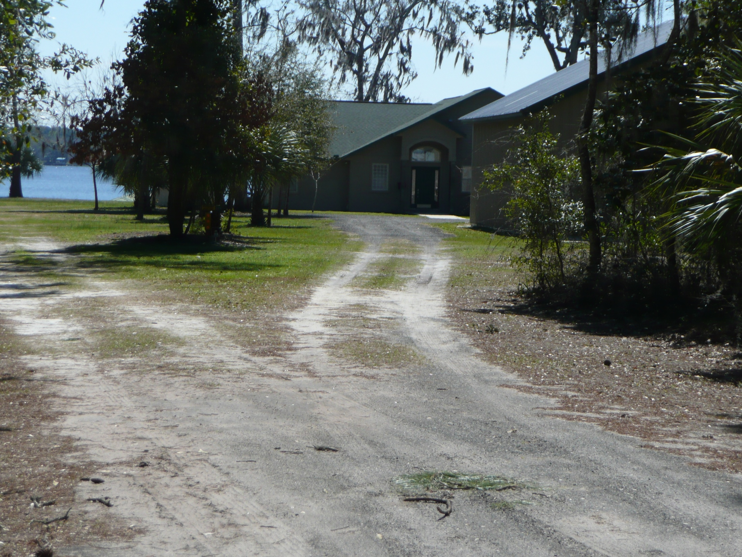
From SECI’s Rebuttal Evidence at II-49

Slide 9
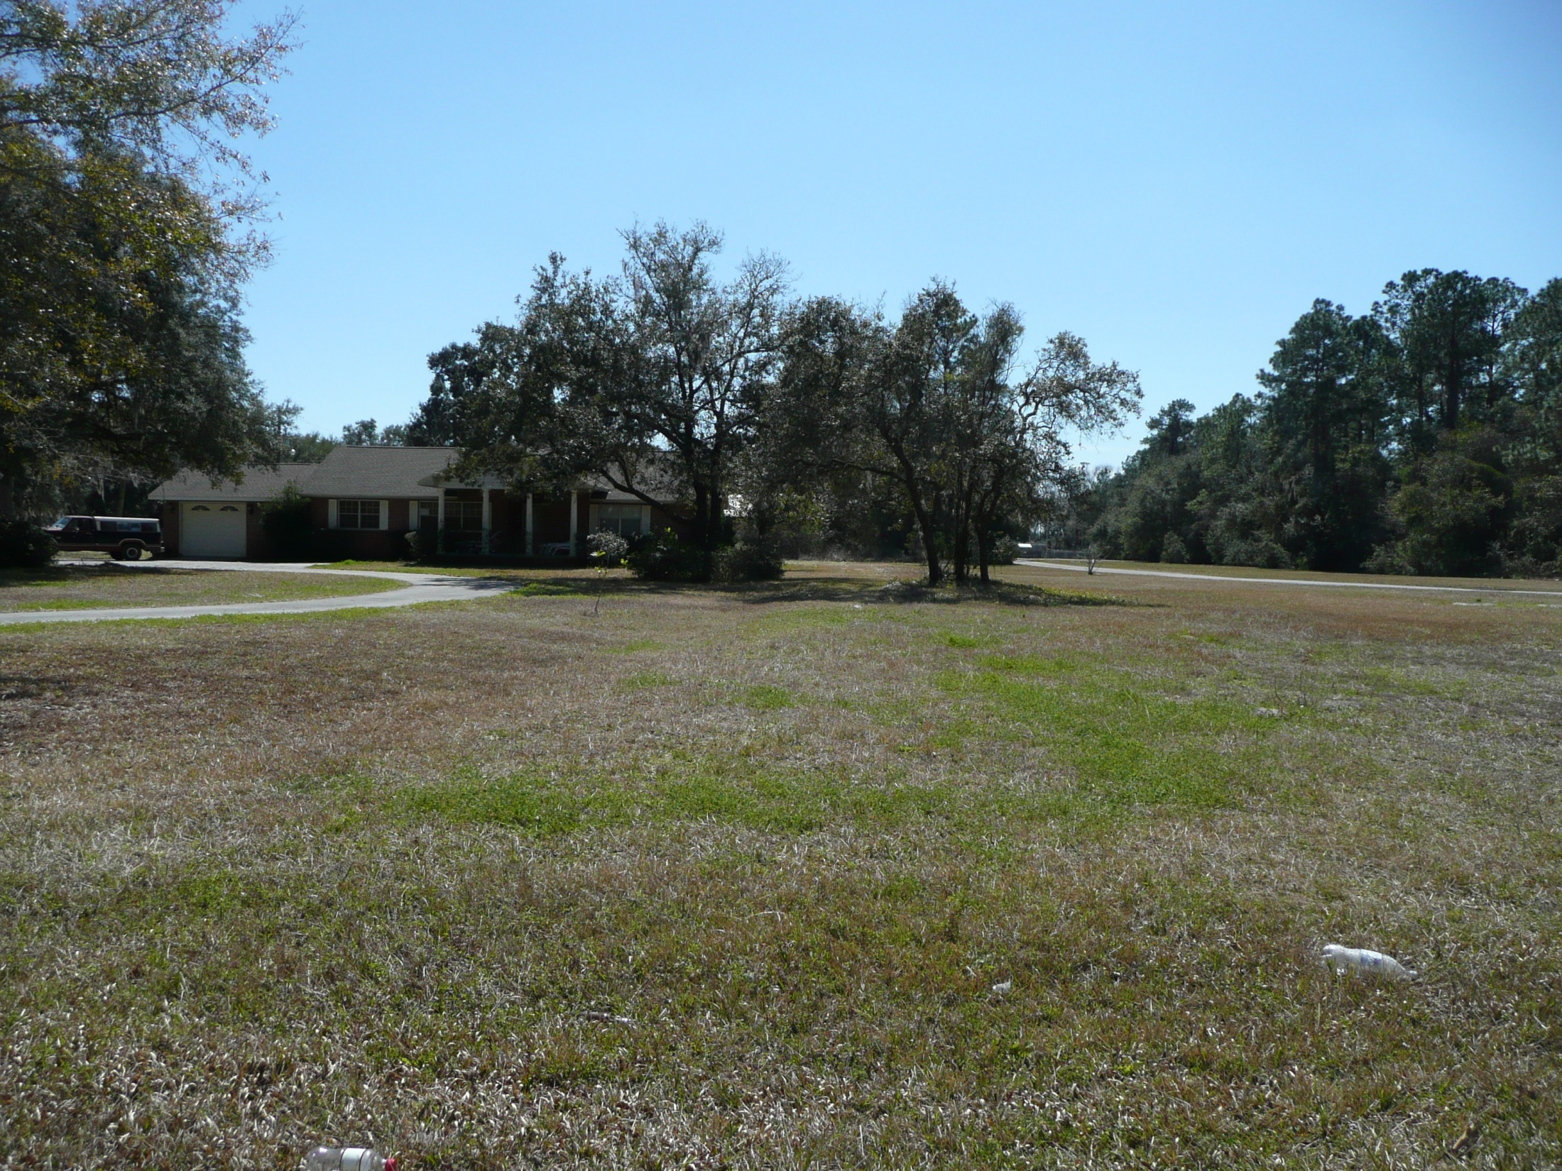
From SECI’s Rebuttal Evidence at II-50

Slide 10
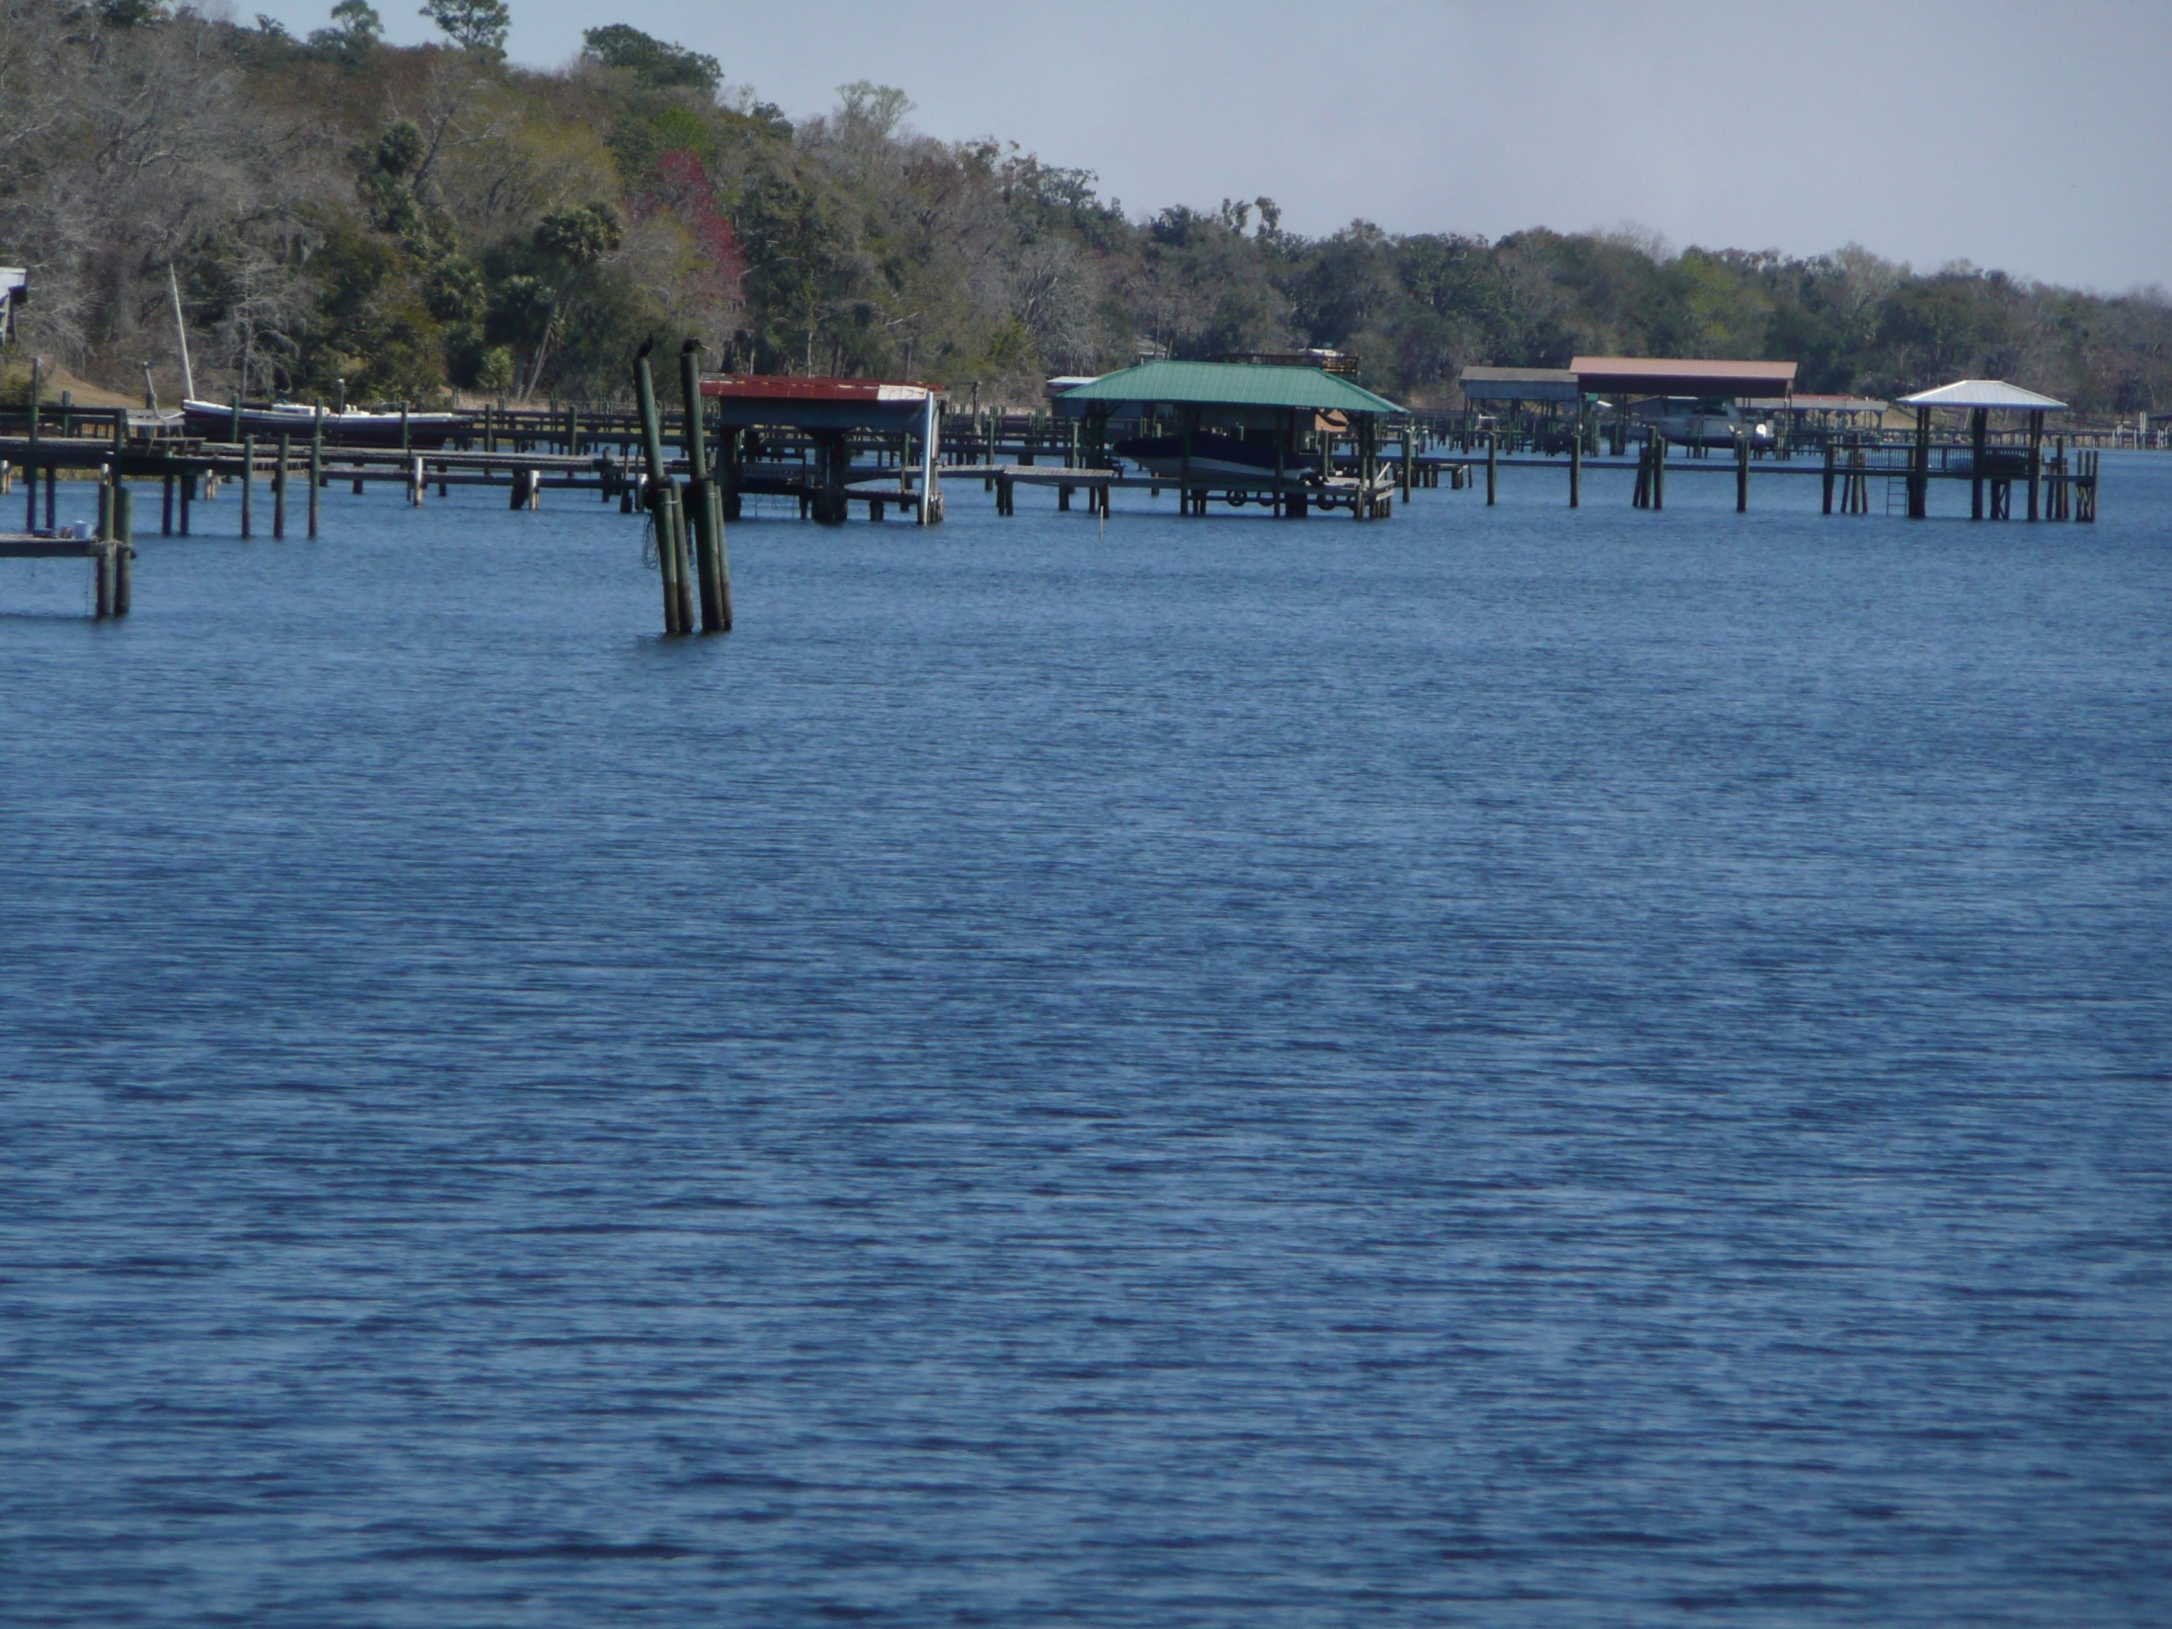
From SECI’s Rebuttal Evidence at II-51

Slide 11
Permitting & Regulatory Requirements
Amend Putnam County’s future land use map to rezone land parcels next to the river;
Obtain Putnam County’s & Florida D.O.T.’s authorization for coal conveyor’s undercrossing/overcrossing of C.R. 209 and associated right-of-way;
Seek authorization from the State Board of Trustees of the Internal Improvement Trust Fund for use of sovereign state lands for portions of dock system in river;
Modify existing SGS site certification by Florida Electrical Power Plant Siting Board;
Seek air construction permit for new facilities and revision of existing air operation & surface water discharge permits for SGS from FL Dept. of Environmental Protection;
Obtain dredge & fill permit from U.S. Army Corp of Engineers for facilities construction in river.
From SECI’s Rebuttal Evidence at II-59

Slide 12
EVA’s Cost Estimates Are Too Low
EVA relies on an outdated source that does not reflect current market conditions
EVA assumes SECI would incur no additional costs for coal shipments originating at
inland barge terminals
EVA provides no support for assumption that barge rates paid by SECI for river coal
transport would always reflect the low end of prevailing spot rates
EVA assumes that coal transfers between river and ocean barges could take place
without delays
EVA assumes CSXT would voluntarily “short-haul” itself on movements from NAPP
mines to ports
EVA underestimates loading/unloading times at all hypothetical points of transfer
thus underestimating capital & operating costs for required transfer crane capacity
EVA ignores costs associated with coal degradation
From SECI’s Closing Brief at 10-11

Slide 14
Rail Transportation Rates to Florida Utilities
Mills Per Ton-Mile
SECI-SGS
Lakeland-McIntosh
Gainesville-Deerhaven
Gulf Power-Schultz
Orlando-Stanton
Progress-Crystal River
From SECI’s Rebuttal Evidence at I-8 (redacted)

