Slide 1
RETAC
Bio Fuels Update
Ft Worth, TX
April 15, 2016

Slide 2
US Corn S & D
High dollar is impacting corn exports
Carryout stocks are growing as a result
Farmers are projected to plant 93.6 Myn acres this spring

Slide 3
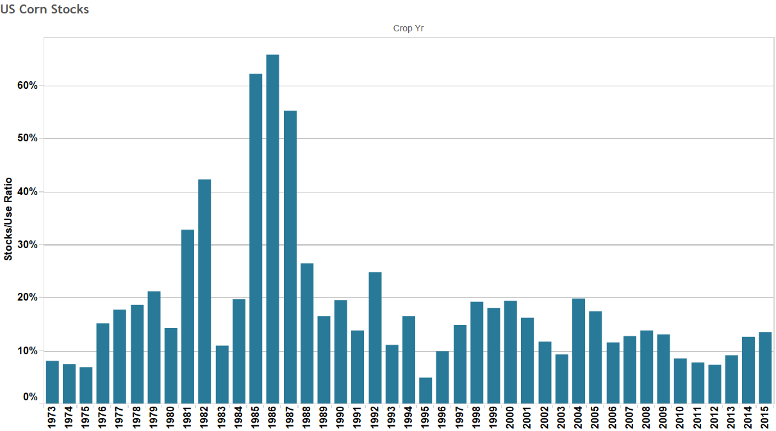
US Corn Stocks to Use Ratio

Slide 4
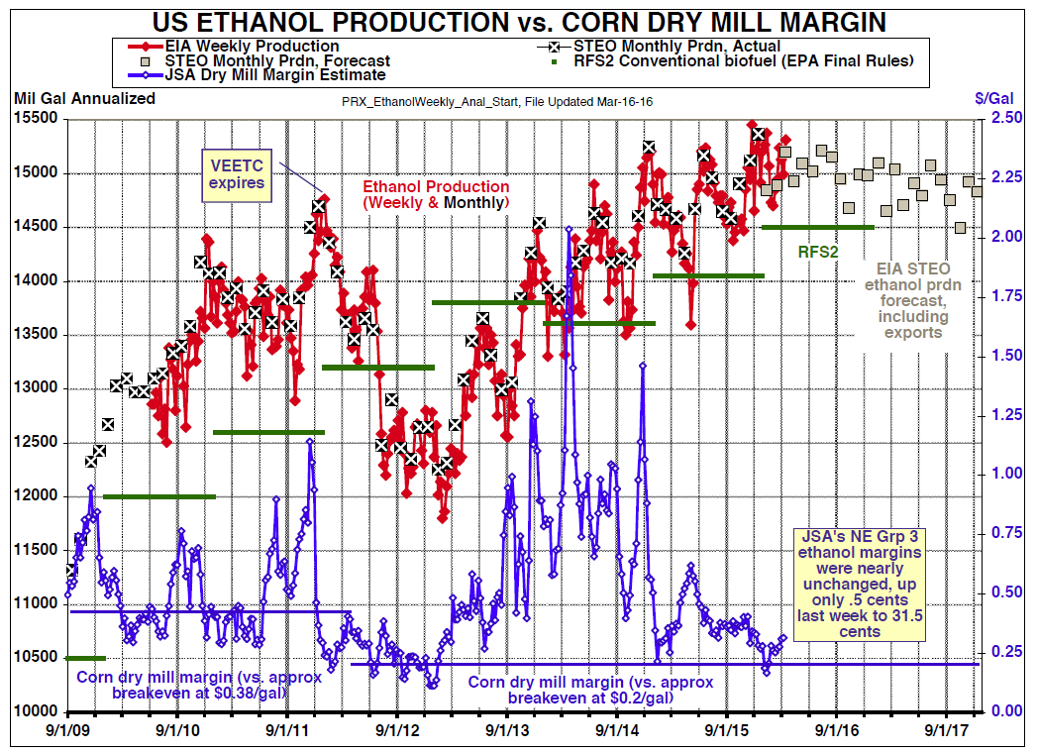
Ethanol Production vs. Dry Mill Margin

Slide 5
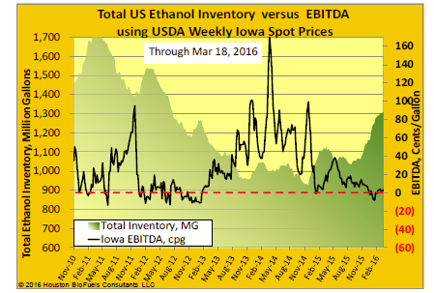
US Ethanol Inventory vs. EBITDA
Plants are running at close to breakeven levels
Returns are down about 12¢/Gal from a year ago

Slide 6
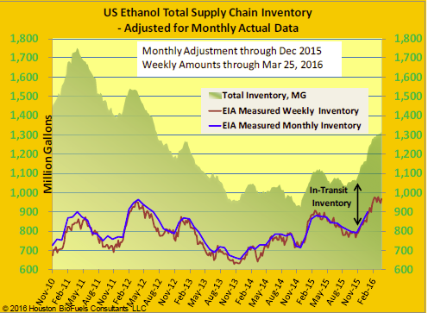
US Ethanol Total Supply Chain Inventory
Inventory is 944 Myn Gal or approximately 33 days of consumption
Production capacity utilization is estimated at 96%

Slide 7
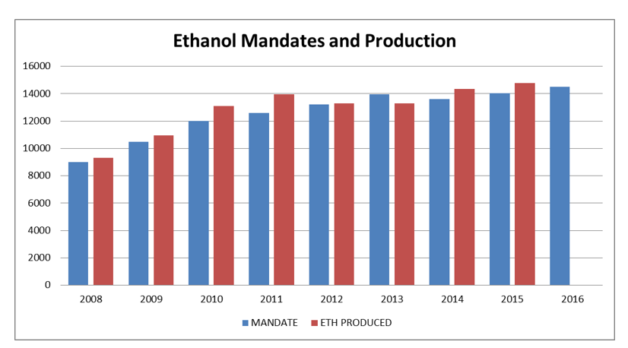
EPA Mandate vs. Ethanol Production

Slide 8
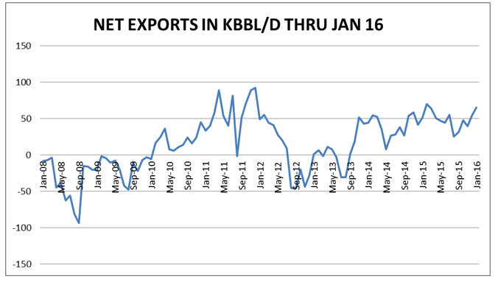
Net Ethanol Exports From US
Exports for February were 66.2 Myn Gal.
Brazil took 22.1 MG. Canada 14.5 MG and China 8.8 MG

Slide 9
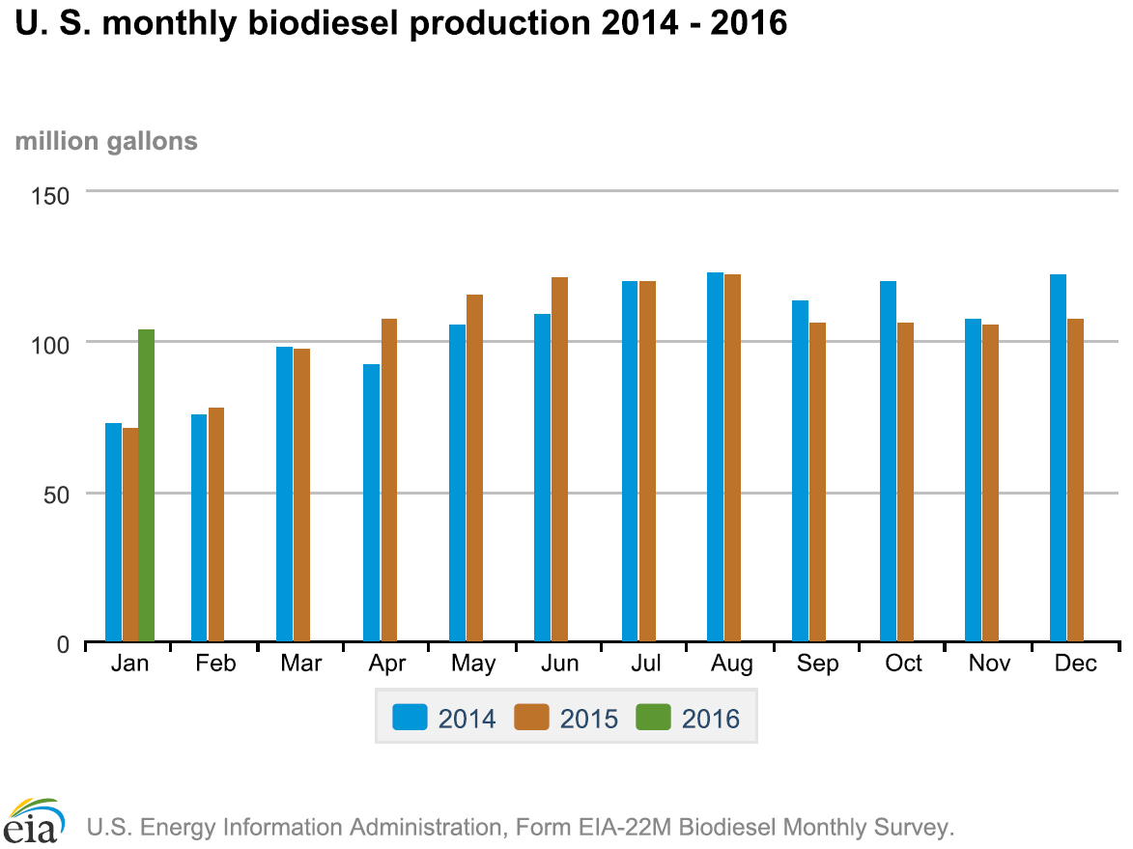
Bio Diesel Production
2015 production was 1.268 BG
2016 production estimated at 1.5 BG
RFS calls for 1.9 BG

Slide 10
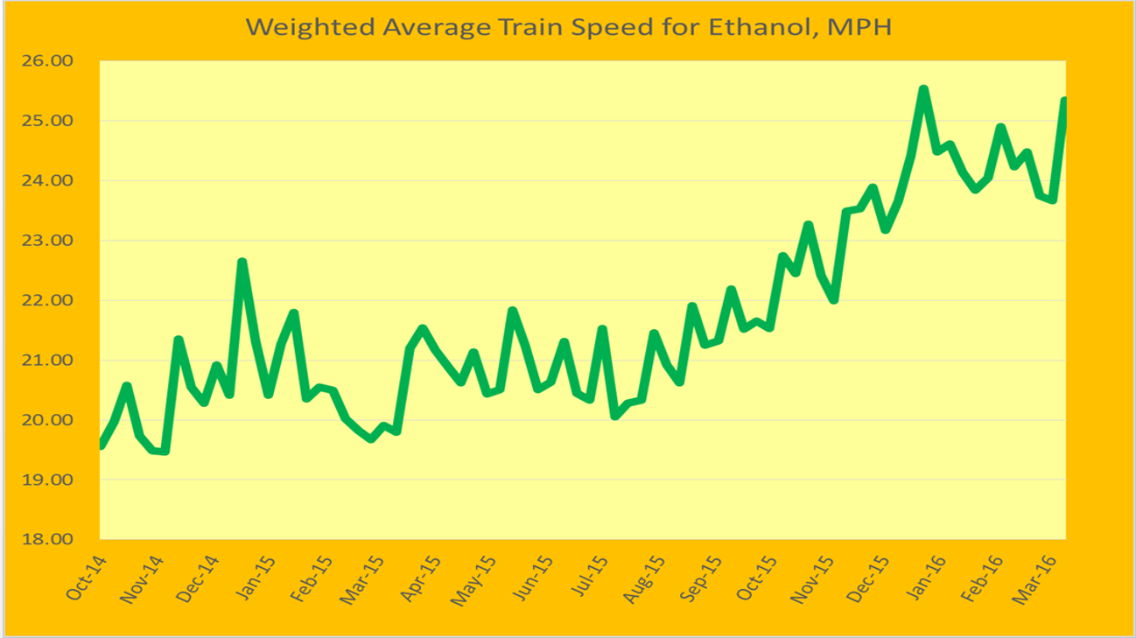
Weighted Average Train Speed for Ethanol in MPH

Slide 11
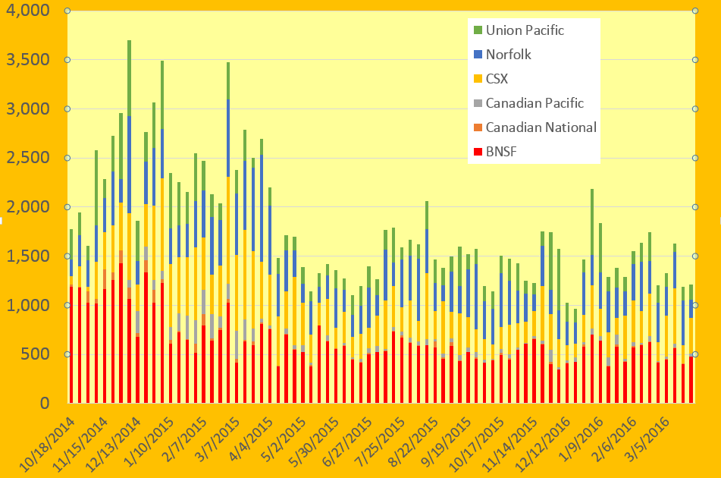
Total Ethanol Trains Not Moved In Greater Than 48 hours

Slide 12
Market Comments
Increase in total gas consumption in the US is helping drive demand for ethanol
Expected increase in cost of corn in E. Corn Belt this summer will likely drive margins to below break even
Plants are becoming more efficient which is contributing to excess supply
A drop in DDG exports to China is hurting price

Slide 13
Rail Service & Equipment
Rail service continues to be good
Heavy tank car requalification's over the next 2 years
Repair facility capacity remains tight
Tank car lease prices are under pressure as more tanks get built than needed

