Slide 1
Oil Industry Segment Update Lee K. Johnson Hess Corporation
Rail Energy Transportation Advisory Committee
Surface Transportation Board
April 15, 2016

Slide 2
US Crude Oil Environment
Prices remain low and volatile
Cushing WTI Spot [Source: EIA Weekly Report]
April 4, 2014 = $101.46
April 3, 2015 = $48.91
April 6, 2016 = $36.82
Producers focused on productivity and cost reduction
Land rig count down 77% from 2014 peak [Source: Baker Hughes]
US production decline – down 2.9% 9/’15 to 1/’16 [Source: EIA]
Current economics favor pipe over rail [Source: RBN Energy]
Crude-by-rail volumes have retreated to 2012 pace [Source: RBN Energy]

Slide 3
Land Oil Rig Count
Region | 2014 Peak | April 2015 | April 2016 | ‘15/’16 Change | Percent
US | 1,595 | 802 | 362 | -440 | -55%
Eagleford | 259 | 137 | 42 | -95 | -69%
Permian | 568 | 285 | 145 | -140 | -49%
Williston | 224 | 91 | 29 | -62 | -68%
Source: Baker Hughes

Slide 4
Volume of Crude by Rail Carloads
Originated Carloads on US Class I Railroads (1,000’s)
Source: Association of American Railroads /Progressive Railroading

Slide 5
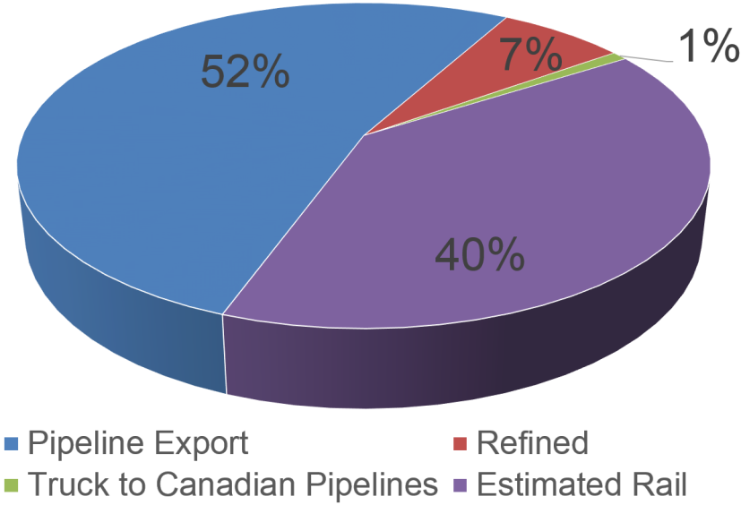
Williston Basin Crude Oil Share
January 2016
 | Average Production/BPO | Rail/BPOD est.
6/2012 | 733,600 | 322,800
6/2013 | 973,500 | 662,000
6/2014 | 1,167,100 | 688,600
6/2015 | 1,245,700 | 585,500
1/2016 | 1,122,100 | 448,800
Source: ND Pipeline Authority – June data 2012-15/January 2016

Slide 6
Williston Basin Crude Oil Export Options (Reported Capacity – Not Market Share)
Rail: Loading terminal capacity/not railroad
Source: North Dakota Pipeline Authority – April, 2015

Slide 7
Closing Thoughts
Oil continues responding to market realities by focusing on efficiency and cost reduction
National production of crude oil has started to decline
Oil continues pursuit of zero defects in the safe and compliant shipping of crude oil by rail
API project to gather historic and current crude oil unit train cycle time data for various markets is underway but is not yet ready for primetime. Expected to be ready for the October meeting.
Sufficient railroad, origin and destination terminal, and tank car fleet capacity exists for current crude-by-rail volumes

