Slide 1
Oil Industry Segment Update
Lee K. Johnson
Rail Energy Transportation Advisory Committee
Surface Transportation Board
March 6, 2014

Slide 2
Regional Oil Production Forecasts
Source: http://www.eia.gov/forecasts/steo/special/pdf/2013_sp_02.pdf

Slide 3



Recent Growth
2.1 million jobs are supported by the unconventional development of crude oil fields, and in 2012 the US GDP was increased by $284 billion
$284
BILLION
US SHALE OIL PRODUCTION
4.17 million barrels/day
380%
increase
2.1 MILLION
J O B S
GDP
0.87 million barrels/day
2010 2030
Source: American Petroleum Institute, FRA, DOT

Slide 4
Why is Shipping Crude Oil by Rail Growing?
Rapid unconventional production volume growth has outpaced traditional oil field export capacity
Initially rail mode was considered a short-term solution until sufficient traditional capacity was developed
The marketplace has enjoyed benefits in rail:
    Capacity may be increased with a typically shorter lead time
    More flexible off-take
      Ability to more effectively adapt to production fluctuations
      Versatility in shipping to multiple markets
    Maximizes Crude Oil Value
      Access to higher demand markets
      Potential availability of more alternatives within each market
      Maintains quality of specification

Slide 5
Consumptive Demand by State
Canadian Oil Sands
Key Crude Oil Rail Origins and Destination Facilities
Bakken
Utica
Niobrara
Anadarko
Thousand Barrels per day
Barnett
Permian
< 500
501 – 1,000
1,001 – 1,900
> 1,900
Unit Train Terminals
Rail Origins
Eagle Ford
Notes:
CSX – Philadelphia Energy/100 car trains/Q1 2013 operation
CSX – Trainor/Delta Airlines Refinery/100 car trains /Q2 2013 operation
CSX – Yorktown, VA/Plains Terminal/100 car trains/Q1 2012 operation
CSX – Toledo, OH/PBF Energy/100 car trains/Q2-Q3 operation
CSX – Albany, NY/Buckeye Terminal – Irving Oil/ 98 car trains/operational
NS – Westville, NJ/Sunoco/100 car trains/operational
NS – Reybold, DE/ PBF Energy/ 100 car trains/operational
CSX – Walnut Hills, FLA/ Genesis Energy/ 100 car trains/operational

Slide 6
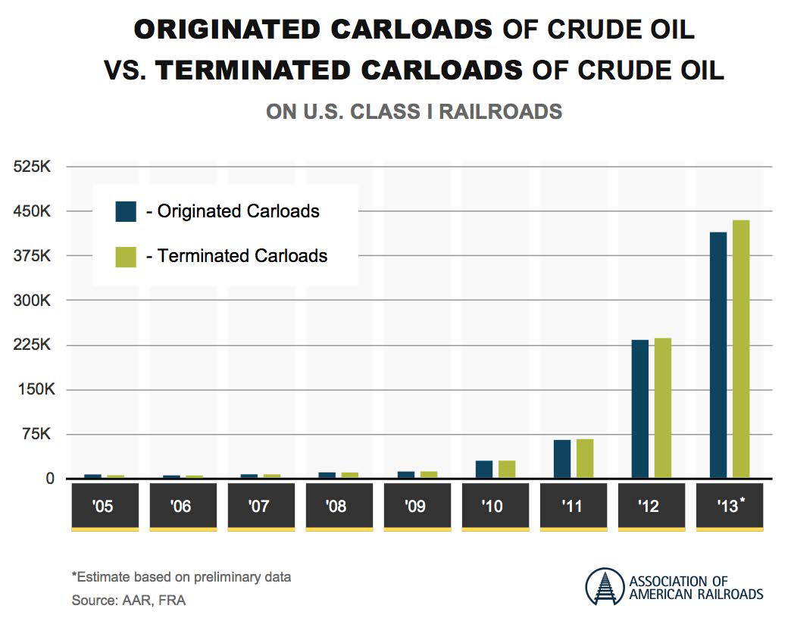
Growth of Crude by Rail Carloads

Slide 7
Growth of Crude by Rail Carloads
Originated Carloads on Class I Railroads (1,000’s)
71% growth
* Estimated based on 1st 3 quarters annualized
Source: US - Association of American Railroads, Dec 2013; Canada – Railway Age

Slide 8
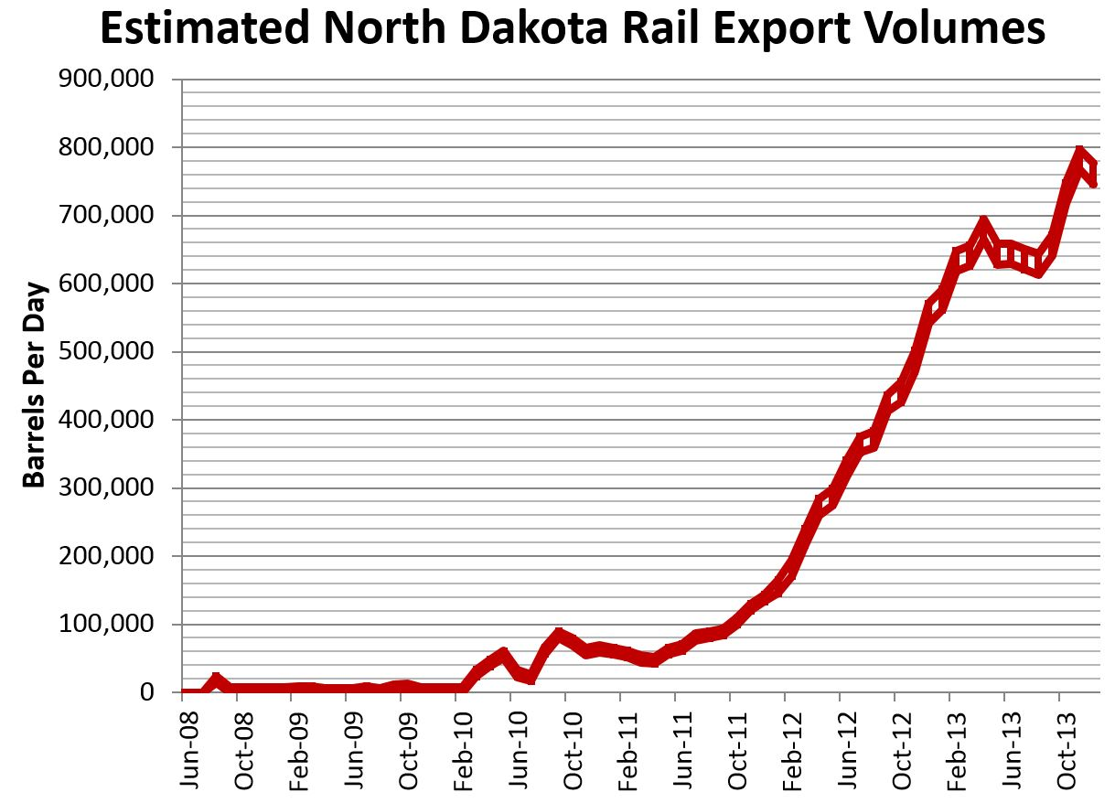
Source: North Dakota Pipeline Authority, December 2013, Update,

Slide 9
Williston Basin Crude Oil Transportation
Source: North Dakota Pipeline Authority, January 2014 Update

Slide 10
Crude-by-Rail Growth Risks
Railroad capacity/service – Winter 2013/2014 has been a challenge
Development of off-take terminals – loading capacity adequate
Adequate tank car fleet – limited manufacturing capacity
Uncertainty regarding ongoing tank car regulatory activity
  FRA and industry have collaborated on design improvement Task Forces T87.5 and T87.6 have resulted in industry implementation of AAR CPC-1232 for Packing Groups I & II
  The 2011 TF T87.6 consensus result is Petition P-1577 before PHMSA for approval
  API/RFA/ACC/CI Petition P-1612 supported by RSI suggests prompt approval of P-1577 specification separate from the “pre-Petition” cars
  Railroads departed from the P-1577 consensus with their ANPRM comments in November, 2013 and moved further away at the January, 2014 AAR Tank Car Committee Meeting
  RSI have moved to recommend the jacketed CPC-1232 car with insulation going forward
  The shipping community continues to support Petitions P-1577 and P-1612 for both the jacketed and non-jacketed specifications pending the results of API Classification and Loading of Crude Oil Standard Development Working Group

Slide 12
North American Tank Car Fleet
North American Tank Car Fleet Additions
Sources: AAR, GATX, Global Insight, Barclays

Slide 13
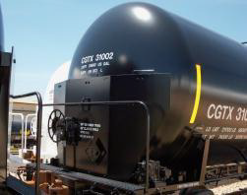

Industry’s Commitment to Safety
The petroleum industry is committed to the safer movement of crude oil and bringing the number of incidents to zero. Shippers are building new tank cars to state-of-the-art standards to meet the growing demand for transporting oil by rail.
60% of the fleet expected to meet these standards by 2015.
CRUDE OIL TANK CAR PRODUCTION
HIGH CAPACITY PRESSURE RELIEF DEVICE
TOP FITTINGS PROTECTION
INCREASED SHELL THICKNESS and HALF HEIGHT HEAD SHIELD
INCREASED PUNCTURE RESISTANCE
68,556
37,356
42,750
ALL TANK CAR PRODUCTION
11,550
over 60% of the fleet
NEW STANDARD TANK CAR PRODUCTION
STATE-OF-THE-ART TANK CAR STANDARDS
2013 2015
Source: American Petroleum Institute (API), FRA, and DOT

Slide 14
Call to Action Meeting Follow-up
Secretary Foxx’s letter of January 22nd confirmed the January 16th path forward:
The API recommended and agreed to the following:
  Share expertise and testing information with DOT, notably PHMSA, about characteristics of crude oil in the Bakken region;
  Work on identifying best practices to ensure that appropriate and comprehensive testing of crude oil being transported by rail is performed; and
  Collaborate with PHMSA on improving its analysis of crude oil characteristics.
Update: API is continuing the ongoing efforts of a technical working group developing an “API Recommended Practice (RP) for Classifying and Loading of Crude Oil into Rail Tank Cars”. The goal is to complete the typical two year process in six months.
Both AAR and API agreed to the following:
  Improve emergency responder capabilities and training to address crude oil incidents; and
  Recommission the AAR Rail Tank Car Standards Committee to reach consensus on additional changes proposed to the AAR rail tank car standard CPC 1232s, to be considered by DOT, as appropriate, in the rulemaking process.
Update: The Task Force T87.6 has again been reconvened and was unable to reach consensus at the first meeting. Cooperative efforts continue.

Slide 15
API Standards Development Process
API has published over 600 standards covering all industry segments
API Standards are:
Core of Institute’s technical authority
Represent industry’s best practices and are used in worldwide operations
Facilitate reasonable regulations
Voluntary
API is accredited by the American National Standards Institute (ANSI) as a standards developing organization (SDO)
API’s procedures explain standardization development process consistent with ANSI’s “Essential Requirements” of Openness, Balance, Consensus, and Due Process
Openness: Participation in API standards activities is open to all parties (persons and organizations) that have a direct and material interest in the subject of a standard.
Balance: API seeks broad input to its standardization activities including the participation of all parties representing interest categories appropriate to the nature of the standard, and allows for open attendance at standards meetings. API strives for balanced representation.
  Consensus: Defined as substantial agreement, not necessarily unanimity.
Due process: Consideration shall be given to the written views and objections of all participants and the right to appeal shall be made available to adversely affected parties.

Slide 16
API Rail Standards Committee/Groups
API Rail Standards Committee (Consensus Standards Committee):
Group that approves the content of a standard by ballot and by its approval, demonstrates evidence of consensus.
One vote per company or organization.
Can be a voting or non-voting member.
API Classification & Loading of Crude Oil Work Group:
Has overall responsibility for developing the draft of the standard.
Companies/Organizations can have multiple representatives.
All with capability for technical contributions can participate.
Rail Standards Committee
Classification & Loading of Crude Oil Work Group
Crude Oil Classification
Task Group
Crude Oil Quantity & Quality Measurement Task Group

Slide 17
API Classifying & Loading of Crude Oil Standard
Scope of API standard:
This document provides guidance on the material characterization, transport classification, and quantity measurement of crude oil, using both lab and field testing techniques, for the loading and unloading of railroad tank cars. The guidance covers the transfer of crude oil into and out of rail tank cars at marine, pipeline and transloading terminals, including cargo tank truck to rail tank car.
This document also provides guidance on the documentation of measurement results.
This document identifies the criteria for determining the frequency that the crude oil should be sampled and tested.

Slide 18
Conclusions
Unconventional production of crude oil is a rapidly growing economic & energy independence contributor
Rail transportation is an important success factor
All stakeholders are committed to the safe and compliant transport of crude oil by rail
Secretary Foxx’s “Call to Action” meeting initiatives are helpful in bringing the stakeholders together to form a fact-based consensus for USDOT consideration
The API Classification & Loading of Crude Oil Working Group and Standard development process are a vital element supporting the regulatory effort.

