Slide 1
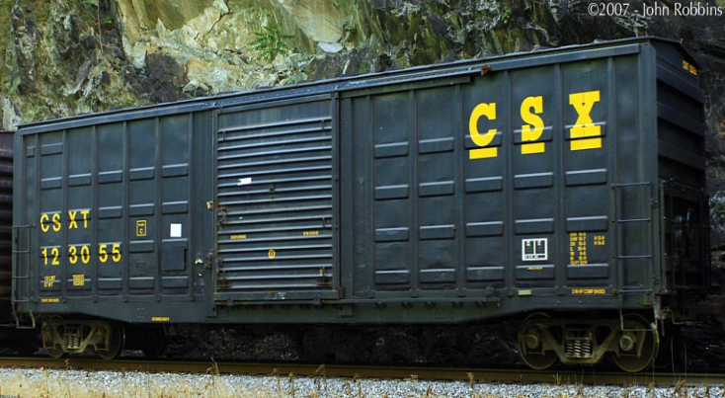
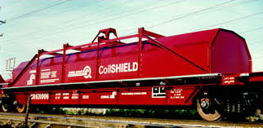
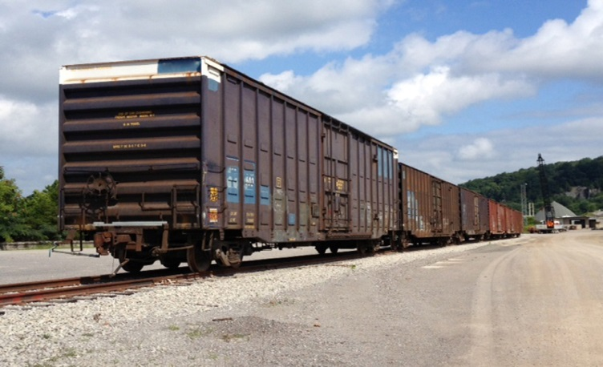
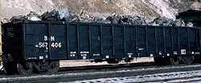
Equipment Review
RSTAC
May 20,2014

Slide 2
Concluding Summary Equipment Review What the Future Holds
Continued rapid growth in goods movement with increasing infrastructure demands
Modal competition for infrastructure dollars – who’s going to pay?
Rail car equipment shortages based on demand – the role of the box car
We’re the solution !

Slide 3
OUR FUTURE

Slide 4
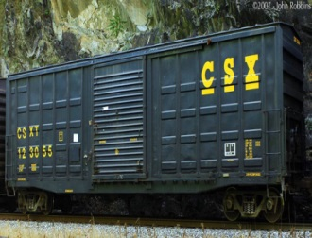
Market Level Activity
Overall freight revenue will grow by 63.6% to $1.3 trillion annually in 2024 and trucking will see its share of those revenue rise to 81% from 80.7% in 2012.
Truckload volumes will grow 3.2% through 2018 and 1.1% annually between 2019 and 2024. Less-than-truckload volume should grow 3.5% annually through 2018 and by 2.4% until 2024.
Anemic growth for rail carloads of just 1.5% through 2018 and 0.4% from 2019 through 2024 contributing to a decline in market share to 14.2% from 14.8% in 2011.
Intermodal rail will continue to be the fastest growing freight mode, growing an average of 5.1% a year until 2018 then slowing moderately to 4.8% annual through 2024. Source: US Freight Transportation Forecast to 2024, ATA
Freight Tonnage Modal Share
Water : 10.3%
Air : .01 %
Trucking : 68.5%
Rail : 14.8
Pipeline:: 10.3

Slide 5
Major Modal Shifts Are In The Past Distribution of Tonnage by Mode: 2012 vs 2024

Slide 6
Recommendations
Incentivize investments in these units : - tax credits – focused amortization - attach federal & state rail freight assistance investment towards equipment where local industry is impacted
Get creative : - view the freight market in total – look at traffic lanes and industry priorities - Railex Brochure ( http://www.railex.com/site/ ) - view these car types – especially box cars – as rolling warehouses – the issue needing a closer look : how do you fully utilize the ENTIRE inside
Create MORE equipment guardians : - Beneficial owners need better coordination – increase the use of pool car network ( shippers, port authorities, more shortline railroads) - Service commitments from Class 1 railroads command managed equipment return activity with resulting balanced train performance - implement financial incentives to along the supply chain to work smarter and more cooperatively

Slide 7
Revisit
Obama Administration’s
New Freight Transport Policy
“ Get trucks off the road”
5 goals
safety
economic competitiveness
state of good repair livability
environmental sustainability
“ No longer can we think of single modes of transport ” (JOC - April 5, 2010)

